Slide 1
Chapter 1 Introduction to Computers, the Internet and Java
Java How to Program, 11/e

Slide 2
Course Objectives
Understand the role of the Application Programming Interfaces (APIs)
Learn to program using a high-level Object Oriented programming language

Slide 3
Chapter Objectives
Describe computer hardware, software, networking basics.
Describe the levels of the data hierarchy within computers.
Describe the different types of programming languages.
Explain object-oriented programming basics.
Describe the components that make up a typical Java programming environment.

Slide 4
1.1 Introduction
Java is one of the world’s most widely used computer programming languages.
You’ll learn to write instructions in the Java programming language commanding computers to perform tasks.
Software (i.e., the instructions you write) controls hardware (i.e., computers).
You’ll learn object-oriented programming—today’s key programming methodology.
You’ll create and work with many software objects.

Slide 5
1.1 Introduction (Cont.)
Java Standard Edition
Java How to Program, 11/e is based on Java Standard Edition 8 (Java SE 8) and Java Standard Edition 9 (Java SE 9)
Java Standard Edition contains the capabilities needed to develop desktop and server applications.

Slide 6
1.1 Introduction (Cont.)
Java Enterprise Edition
Java is used in such a broad spectrum of applications that it has two other editions.
The Java Enterprise Edition (Java EE) is geared toward developing large-scale, distributed networking applications and web-based applications.

Slide 7
1.1 Introduction (Cont.)
Java Micro Edition (Java ME)
Subset of Java SE.
Geared toward developing applications for resource-constrained embedded devices, such as
Smartwatches
MP3 players
television set-top boxes
smart meters (for monitoring electric energy usage)
and more.
Many of the devices in use Java ME.

Slide 8
1.2 Hardware and Software
Computers process data under the control of sequences of instructions called computer programs.
These software programs guide the computer through ordered actions specified by people called computer programmers.
You’ll learn a key programming methodology that’s enhancing programmer productivity, thereby reducing software development costs—object-oriented programming.

Slide 9
1.2.1 Moore’s Law
Every year or two, the capacities of computers have approximately doubled inexpensively.
This remarkable trend often is called Moore’s Law.
Named for the person who identified the trend, Gordon Moore, co-founder of Intel.

Slide 10
1.2.2 Computer Organization
Computers can be envisioned as divided into various logical units or sections.
Figure 1.2 provides an overview of the logical units

Slide 11
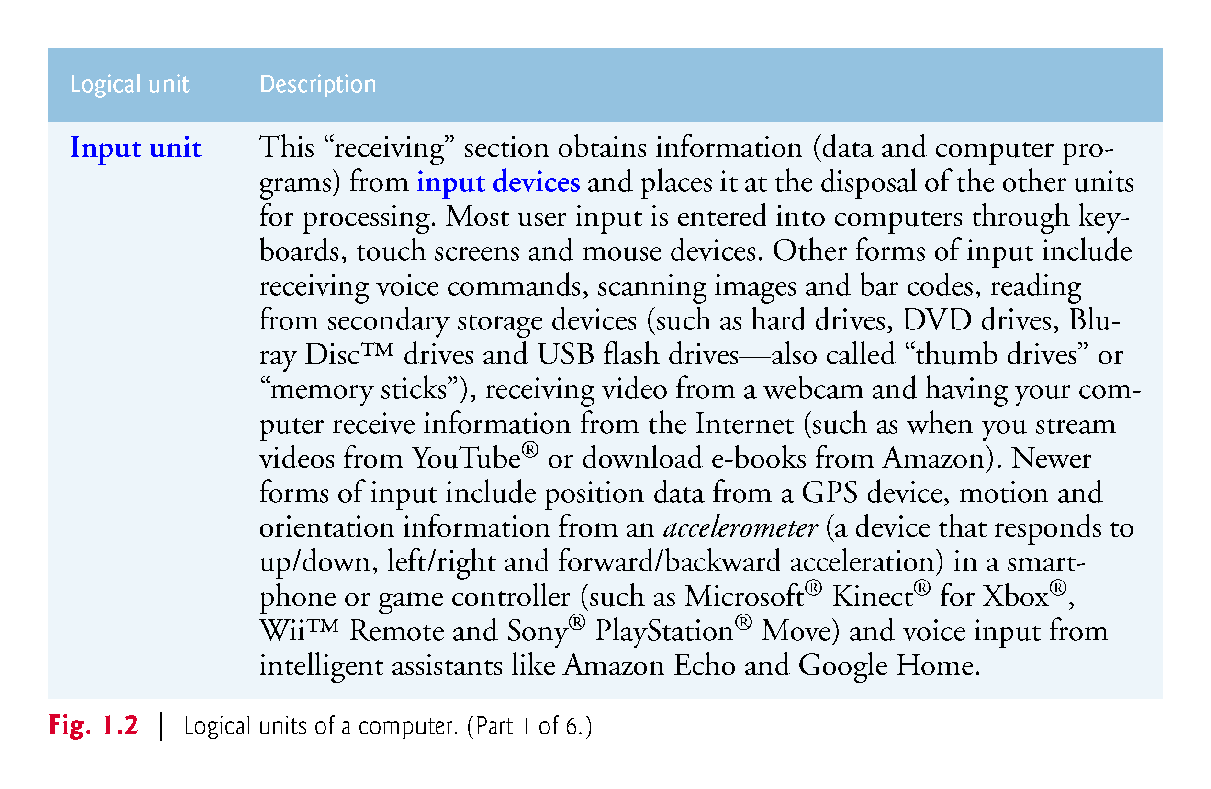

Slide 12
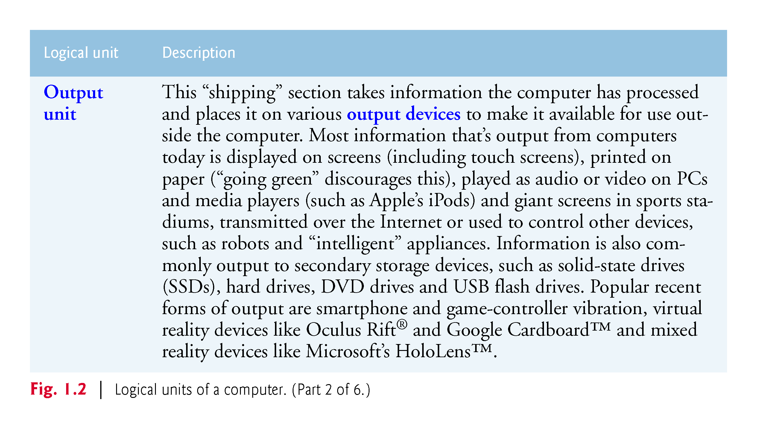

Slide 13
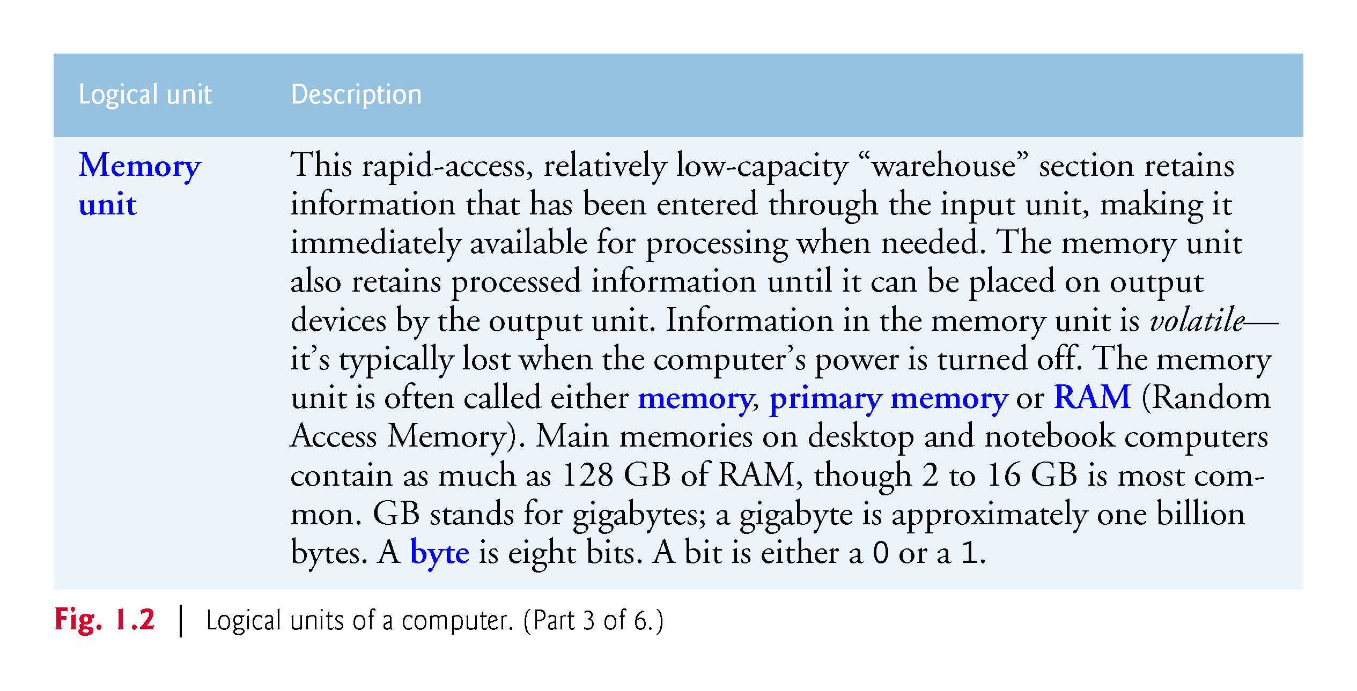

Slide 14
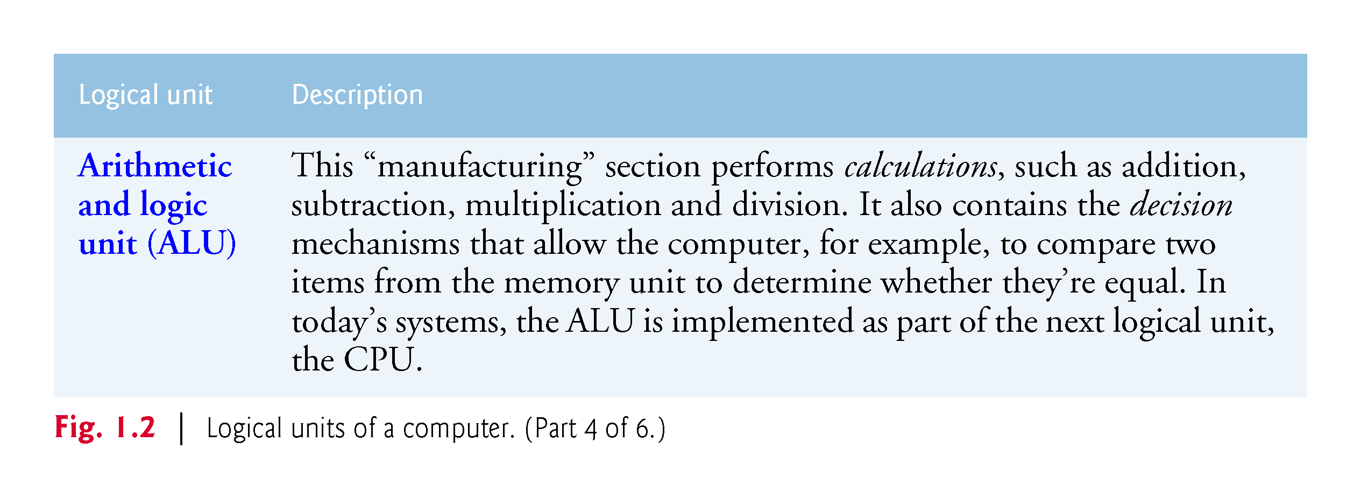

Slide 15
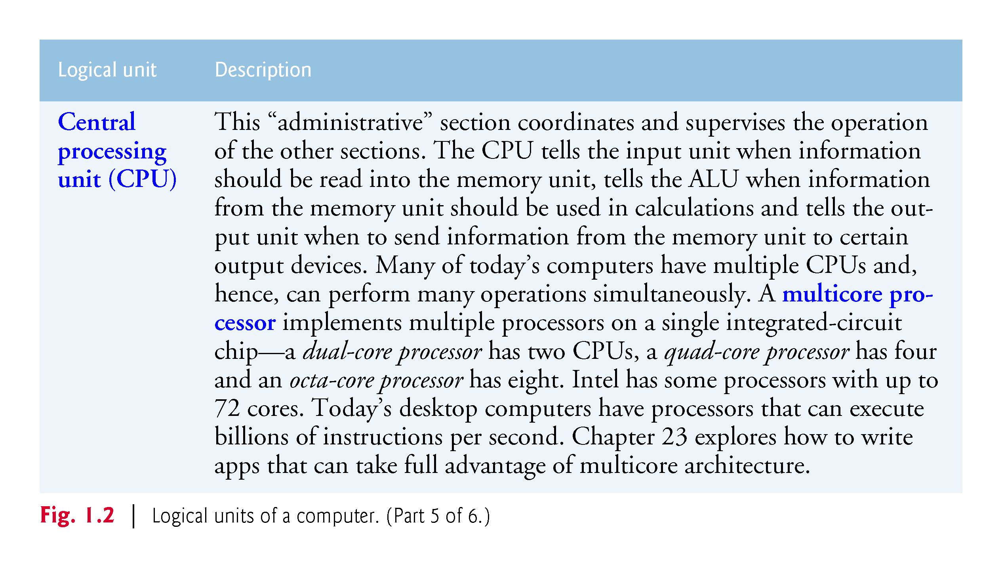

Slide 16
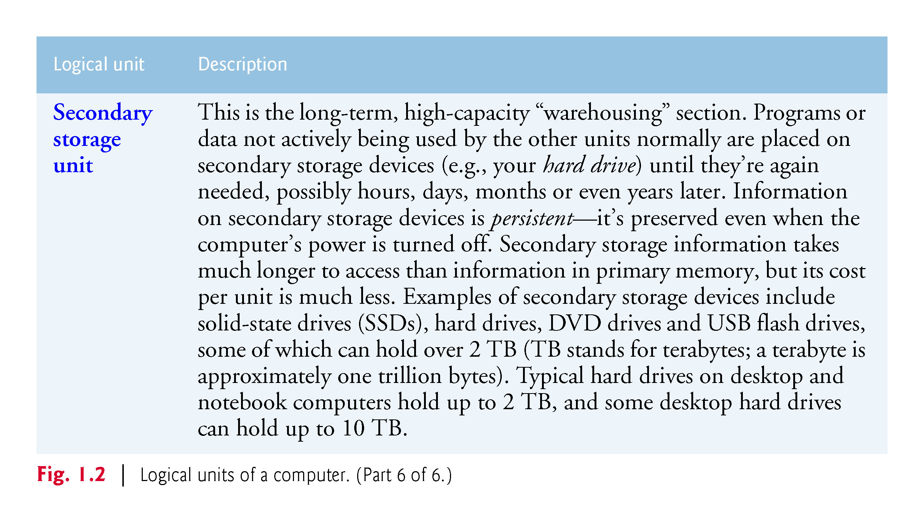

Slide 17
1.3 Data Hierarchy
Data items processed by computers form a data hierarchy that becomes larger and more complex in structure as we progress from the simplest data items (called “bits”) to richer ones, such as characters and fields.

Slide 18
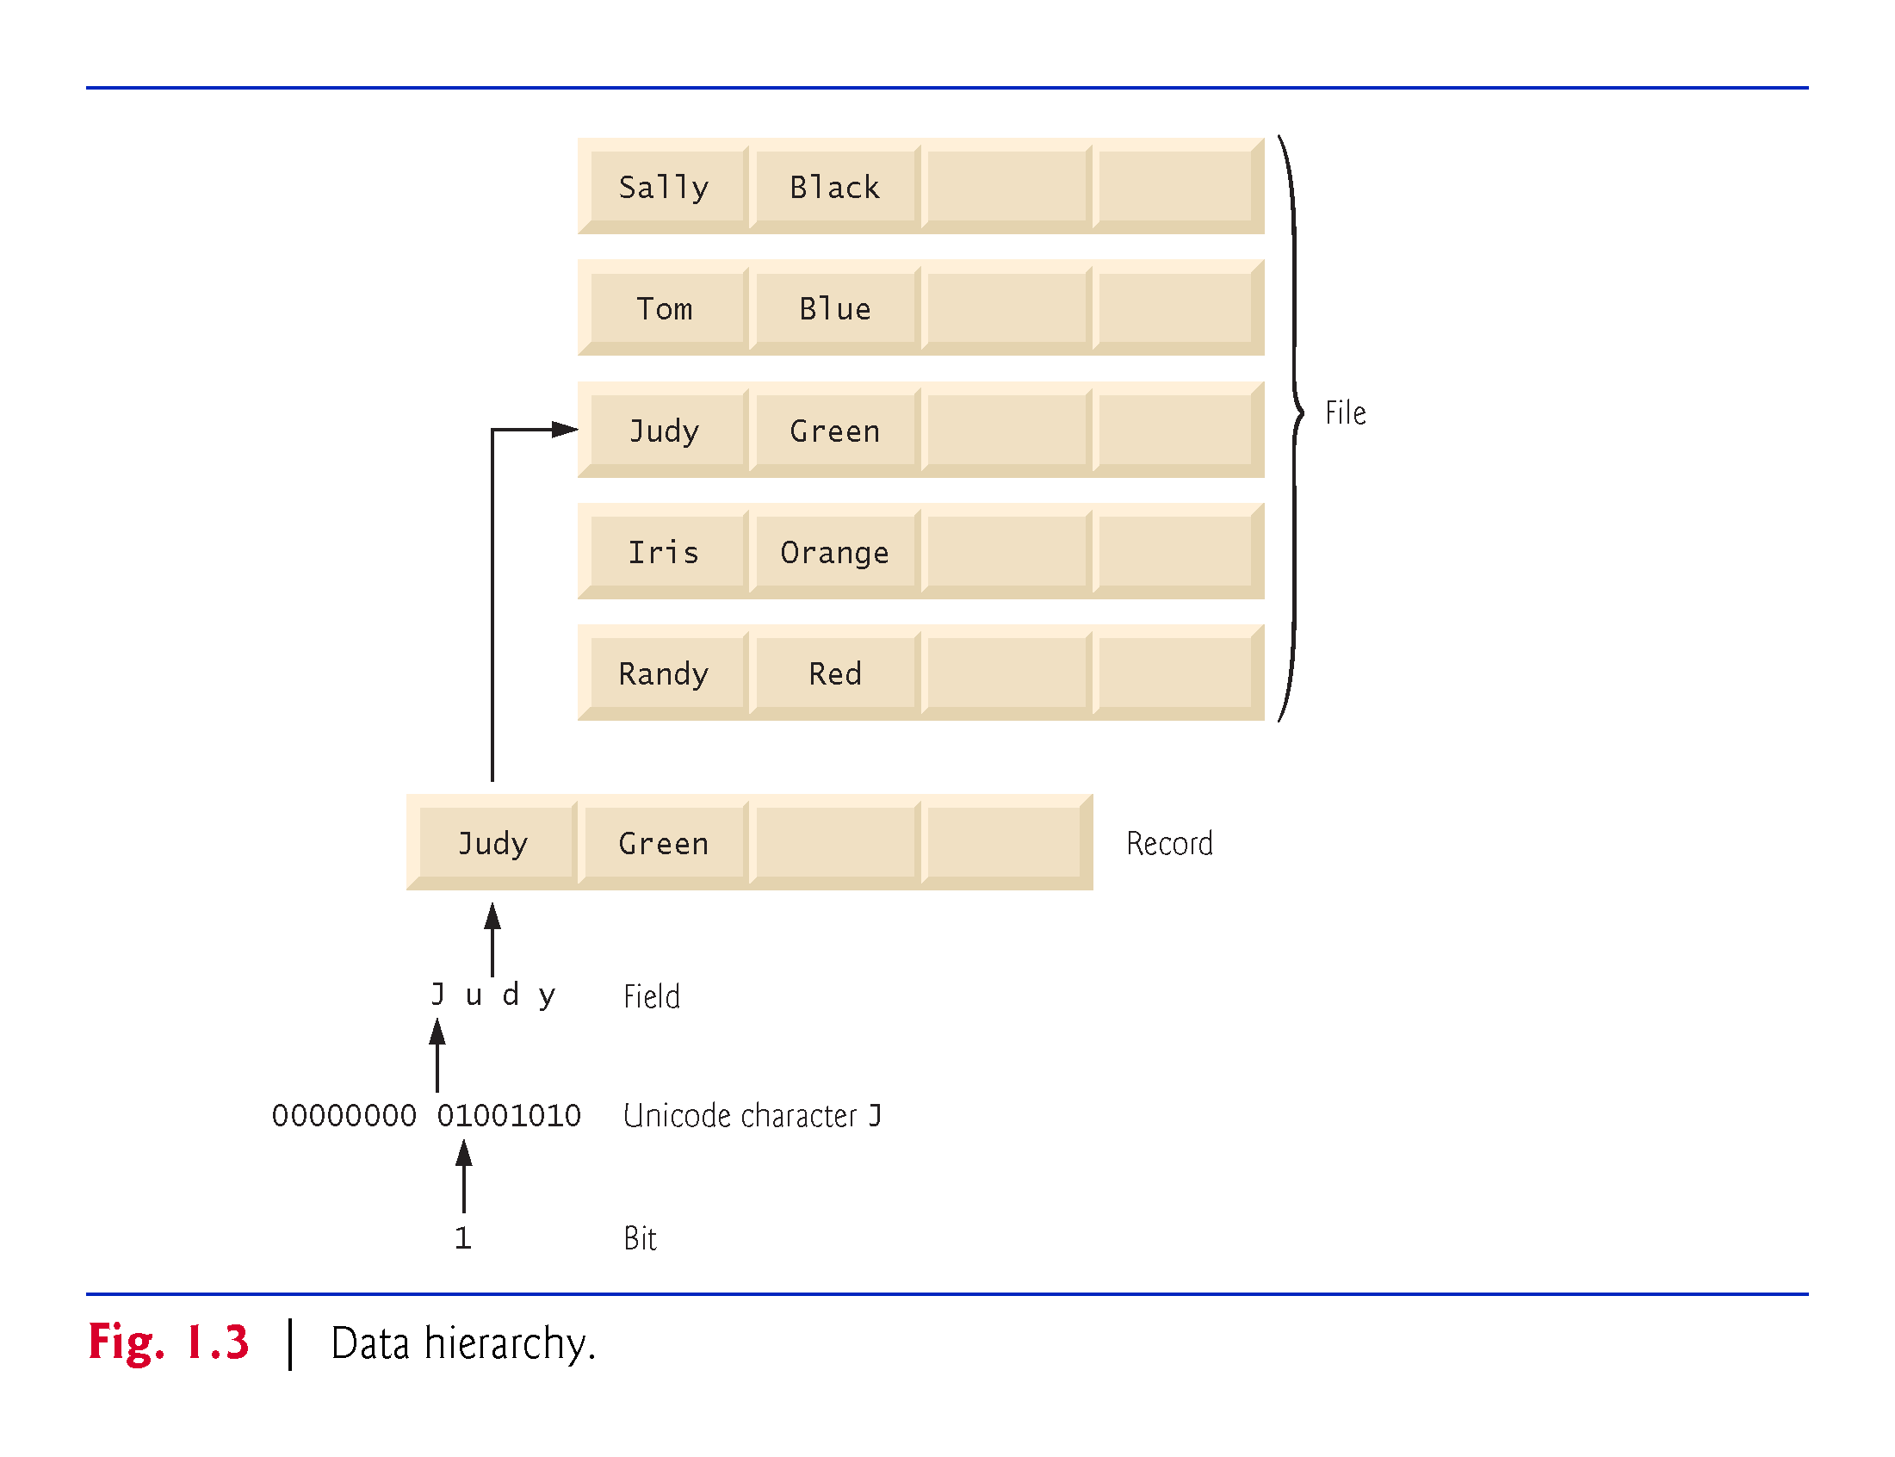

Slide 19
1.3 Data Hierarchy (Cont.)
Bits
The smallest data item in a computer can assume the value 0 or the value 1.
Such a data item is called a bit (short for “binary digit”—a digit that can assume either of two values).
Remarkably, the impressive functions performed by computers involve only the simplest manipulations of 0s and 1s—examining a bit’s value, setting a bit’s value and reversing a bit’s value (from 1 to 0 or from 0 to 1).

Slide 20
1.3 Data Hierarchy (Cont.)
Characters
We prefer to work with decimal digits (0–9), uppercase letters (A–Z), lowercase letters (a–z), and special symbols (e.g., $, @, %, &, *, (, ), –, +, ", :, ? and / ).
Digits, letters and special symbols are known as characters. The computer’s character set is the set of all the characters used to write programs and represent data items on that device.
Computers process only 1s and 0s, so every character is represented as a pattern of 1s and 0s.
Java uses Unicode® characters that are composed of one, two or four bytes (8, 16 or 32 bits).
Unicode contains characters for many of the world’s languages.

Slide 21
1.3 Data Hierarchy (Cont.)
Fields
Just as characters are composed of bits, fields are composed of characters or bytes.
A field is a group of characters or bytes that conveys meaning.
For example, a field consisting of uppercase and lowercase letters could be used to represent a person’s name, and a field consisting of decimal digits could represent a person’s age.

Slide 22
1.3 Data Hierarchy (Cont.)
Records
Several related fields can be used to compose a record (implemented as a class in Java).
In a payroll system, for example, the record for an employee might consist of the following fields (possible types for these fields are shown in parentheses):
Employee identification number (a whole number)
Name (a string of characters)
Address (a string of characters)
Hourly pay rate (a number with a decimal point)
Year-to-date earnings (a number with a decimal point)
Amount of taxes withheld (a number with a decimal point)
Thus, a record is a group of related fields.
In the preceding example, all the fields belong to the same employee.

Slide 23
1.3 Data Hierarchy (Cont.)
Files
A file is a group of related records.
More generally, a file contains arbitrary data in arbitrary formats.
In some operating systems, a file is viewed simply as a sequence of bytes—any organization of the bytes in a file, such as organizing the data into records, is a view created by the application programmer.

Slide 24
1.3 Data Hierarchy (Cont.)
Database
A database is a collection of data that’s organized for easy access and manipulation.
The most popular database model is the relational database in which data is stored in simple tables.
A table includes records and fields.
For example, a table of students might include first name, last name, major, year, student ID number and grade point average fields.
The data for each student is a record, and the individual pieces of information in each record are the fields.
You can search, sort and otherwise manipulate the data based on its relationship to multiple tables or databases.

Slide 25
1.4 Machine Languages, Assembly Languages and High-Level Languages
Programmers write instructions in various programming languages, some directly understandable by computers and others requiring intermediate translation steps.
These may be divided into three general types:
Machine languages
Assembly languages
High-level languages

Slide 26
1.4 Machine Languages, Assembly Languages and High-Level Languages (Cont.)
Machine Languages
Any computer can directly understand only its own machine language, defined by its hardware design.
Generally consist of strings of numbers (ultimately reduced to 1s and 0s) that instruct computers to perform their most elementary operations one at a time.
Machine dependent—a particular ma-chine language can be used on only one type of computer.
Assembly Languages and Assemblers
English-like abbreviations that represent elementary operations formed the basis of assembly languages.
Translator programs called assemblers convert early assembly-language programs to machine language.

Slide 27
1.4 Machine Languages, Assembly Languages and High-Level Languages (Cont.)
High-Level Languages and Compilers
High-level languages
Single statements accomplish substantial tasks.
Compilers convert high-level language programs into machine language.
Allow you to write instructions that look almost like everyday English and contain commonly used mathematical notations.
A payroll program written in a high-level language might contain a single statement such as
grossPay = basePay + overTimePay
Interpreters
Compiling a high-level language program into machine language can take considerable computer time.
Interpreter programs, developer to execute high-level language programs directly, avoid the delay or compilation, although they run slower than compiled programs.

Slide 28
1.5 Introduction to Object Technology
Objects, or more precisely, the classes objects come from, are essentially reusable software components.
There are date objects, time objects, audio objects, video objects, automobile objects, people objects, etc.
Almost any noun can be reasonably represented as a software object in terms of attributes (e.g., name, color and size) and behaviors (e.g., calculating, moving and communicating).
Software development groups can use a modular, object-oriented design-and-implementation approach to be much more productive than with earlier popular techniques like “structured programming”—object-oriented programs are often easier to understand, correct and modify.

Slide 29
1.5.1 The Automobile as an Object
Automobile as an Object
Let’s begin with a simple analogy.
Suppose you want to drive a car and make it go faster by pressing its accelerator pedal.
Before you can drive a car, someone has to design it.
A car typically begins as engineering drawings, similar to the blueprints that describe the design of a house.
Drawings include the design for an accelerator pedal.
Pedal hides from the driver the complex mechanisms that actually make the car go faster, just as the brake pedal hides the mechanisms that slow the car, and the steering wheel “hides” the mechanisms that turn the car.

Slide 30
1.5.1 The Automobile as an Object (Cont.)
Enables people with little or no knowledge of how engines, braking and steering mechanisms work to drive a car easily.
Before you can drive a car, it must be built from the engineering drawings that describe it.
A completed car has an actual accelerator pedal to make it go faster, but even that’s not enough—the car won’t accelerate on its own (hopefully!), so the driver must press the pedal to accelerate the car.

Slide 31
1.5.2 Methods and Classes
Performing a task in a program requires a method.
The method houses the program statements that actually perform its tasks.
Hides these statements from its user, just as the accelerator pedal of a car hides from the driver the mechanisms of making the car go faster.
In Java, we create a program unit called a class to house the set of methods that perform the class’s tasks.
A class is similar in concept to a car’s engineering drawings, which house the design of an accelerator pedal, steering wheel, and so on.

Slide 32
1.5.3 Instantiation
Just as someone has to build a car from its engineering drawings before you can actually drive a car, you must build an object of a class before a program can perform the tasks that the class’s methods define.
An object is then referred to as an instance of its class.

Slide 33
1.5.4 Reuse
Just as a car’s engineering drawings can be reused many times to build many cars, you can reuse a class many times to build many objects.
Reuse of existing classes when building new classes and programs saves time and effort.
Reuse also helps you build more reliable and effective systems, because existing classes and components often have undergone extensive testing, debugging and performance tuning.
Just as the notion of interchangeable parts was crucial to the Industrial Revolution, reusable classes are crucial to the software revolution that has been spurred by object technology.

Slide 34
1.5.5 Messages and Method Calls
When you drive a car, pressing its gas pedal sends a message to the car to perform a task—that is, to go faster.
Similarly, you send messages to an object.
Each message is implemented as a method call that tells a method of the object to perform its task.

Slide 35
1.5.6 Attributes and Instance Variables
A car has attributes
Color, its number of doors, the amount of gas in its tank, its current speed and its record of total miles driven (i.e., its odometer reading).
The car’s attributes are represented as part of its design in its engineering diagrams.
Every car maintains its own attributes.
Each car knows how much gas is in its own gas tank, but not how much is in the tanks of other cars.

Slide 36
1.5.6 Attributes and Instance Variables (Cont.)
An object, has attributes that it carries along as it’s used in a program.
Specified as part of the object’s class.
A bank-account object has a balance attribute that represents the amount of money in the account.
Each bank-account object knows the balance in the account it represents, but not the balances of the other accounts in the bank.
Attributes are specified by the class’s instance variables.

Slide 37
1.5.7 Encapsulation and Information Hiding
Classes (and their objects) encapsulate, i.e., encase, their attributes and methods.
Objects may communicate with one another, but they’re normally not allowed to know how other objects are implemented—implementation details can be hidden within the objects themselves.
Information hiding, as we’ll see, is crucial to good software engineering.

Slide 38
1.5.8 Inheritance
A new class of objects can be created conveniently by inheritance—the new class (called the subclass) starts with the characteristics of an existing class (called the superclass), possibly customizing them and adding unique characteristics of its own.
In our car analogy, an object of class “convertible” certainly is an object of the more general class “automobile,” but more specifically, the roof can be raised or lowered.

Slide 39
1.5.9 Interfaces
Interfaces are collections of related methods that typically enable you to tell objects what to do, but not how to do it (we’ll see exceptions to this in Java SE 8 and 9 when we discuss interfaces in Chapter 10).
In the car analogy, a “basic-driving-capabilities” interface consisting of a steering wheel, an accelerator pedal and a brake pedal would enable a driver to tell the car what to do.
Once you know how to use this interface for turning, accelerating and braking, you can drive many types of cars, even though manufacturers may implement these systems differently.

Slide 40
1.5.9 Interfaces (Cont.)
A class implements zero or more interfaces, each of which can have one or more methods, just as a car implements separate interfaces for basic driving functions, controlling the radio, controlling the heating and air conditioning systems, and the like.
Just as car manufacturers implement capabilities differently, classes may implement an interface’s methods differently.

Slide 41
1.5.10 Object-Oriented Analysis and Design (OOAD)
How will you create the code (i.e., the program instructions) for your programs?
Follow a detailed analysis process for determining your project’s requirements (i.e., defining what the system is supposed to do)
Develop a design that satisfies them (i.e., specifying how the system should do it).
Carefully review the design (and have your design reviewed by other software professionals) before writing any code.

Slide 42
1.5.10 Object-Oriented Analysis and Design (OOAD) (Cont.)
Analyzing and designing your system from an object-oriented point of view is called an object-oriented-analysis-and-design (OOAD) process.
Languages like Java are object oriented.
Object-oriented programming (OOP) allows you to implement an object-oriented design as a working system.

Slide 43
1.5.11 The UML (Unified Modeling Language)
The Unified Modeling Language (UML) is the most widely used graphical scheme for modeling object-oriented systems.

Slide 44
1.6 Operating Systems
Software systems that make using computers more convenient.
Provide services that allow each application to execute safely, efficiently and concurrently (i.e., in parallel) with other applications.
The software that contains the core components of the operating system is called the kernel.
Popular desktop operating systems include Linux, Windows 7 and macOS.
The most popular mobile operating systems used in smartphones and tablets are Google’s Android and Apple’s iOS (for its iPhone, iPad and iPod Touch devices)

Slide 45
1.6.1 Windows—A Proprietary Operating System
Mid-1980s: Microsoft developed the Windows operating system, consisting of a graphical user interface built on top of DOS—an enormously popular personal-computer operating system that users interacted with by typing commands.
Windows borrowed from many concepts (such as icons, menus and windows) developed by Xerox PARC and popularized by early Apple Macintosh operating systems.
Windows is a proprietary operating system—it’s controlled by Microsoft exclusively.

Slide 46
1.6.2 Linux—An Open Source Operating System
The Linux operating system is perhaps the greatest success of the open-source movement
Open-source software departs from the proprietary software development style that dominated software’s early years
With open-source development, individuals and companies contribute their efforts in developing, maintaining and evolving software in exchange for the right to use that software for their own purposes, typically at no charge

Slide 47
1.6.2 Linux—An Open Source Operating System (cont.)
Open-source code is often scrutinized by a much larger audience than proprietary software, so errors often get removed faster
Open source also encourages innovation. Enterprise systems companies, such as IBM, Oracle and many others, have made significant investments in Linux open-source development
The Linux kernel is the core of the most popular open-source, freely distributed, full-featured operating system

Slide 48
1.6.3 Apple’s macOS and Apple’s iOS for iPhone®, iPad® and iPod Touch® Devices
Apple, founded in 1976 by Steve Jobs and Steve Wozniak, quickly became a leader in personal computing
In 1979, Jobs and several Apple employees visited Xerox PARC (Palo Alto Research Center) to learn about Xerox’s desktop computer that featured a graphical user interface (GUI)
That GUI served as the inspiration for the Apple Macintosh, launched with much fanfare in a memorable Super Bowl ad in 1984

Slide 49
1.6.4 Google's Android
Android—the fastest growing mobile and smartphone operating system—is based on the Linux kernel and Java.
One benefit of developing Android apps is the openness of the platform—the operating system is open source and free.
The Android operating system was developed by Android, Inc., which was acquired by Google in 2005.
In 2007, the Open Handset Alliance was formed to develop, maintain and evolve Android, driving innovation in mobile technology and improving the user experience while reducing costs

Slide 50
1.7 Programming Languages
Figure 1.6 provides brief comments on several popular programming languages. In the next section, we introduce Java.

Slide 51
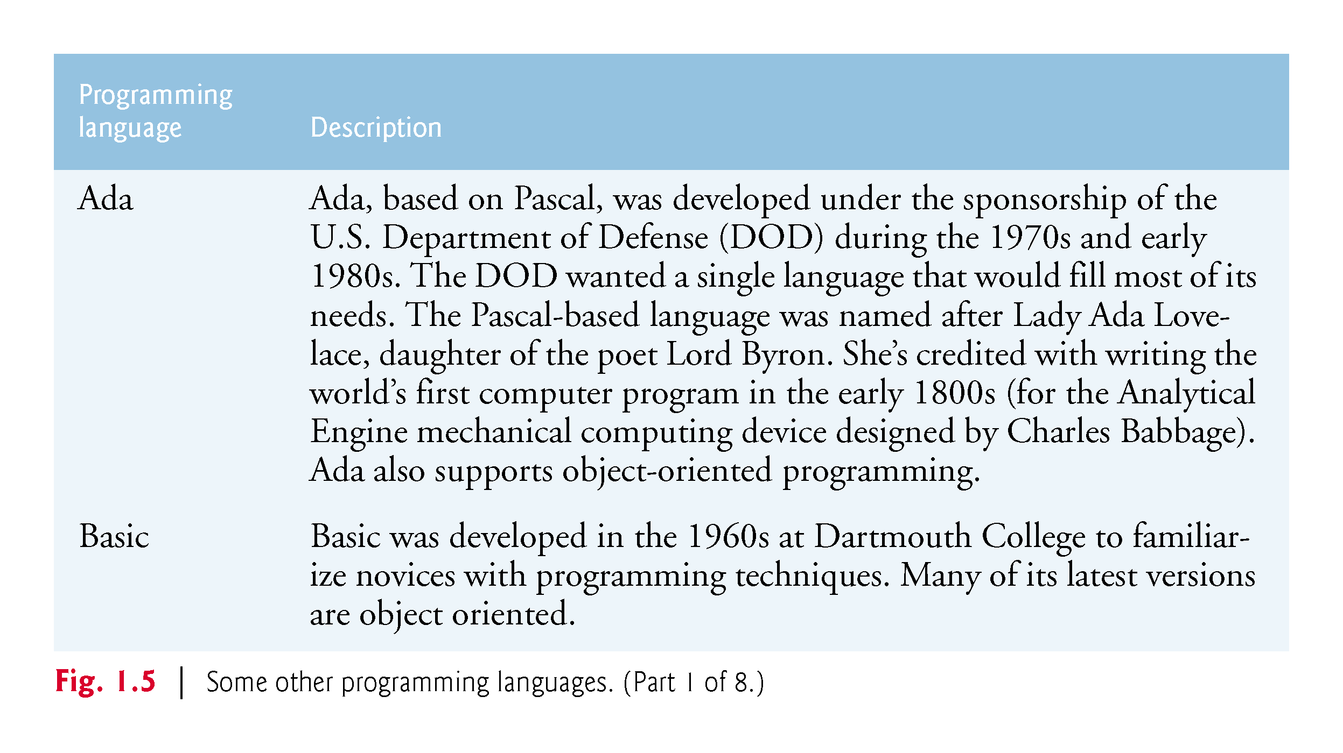

Slide 52
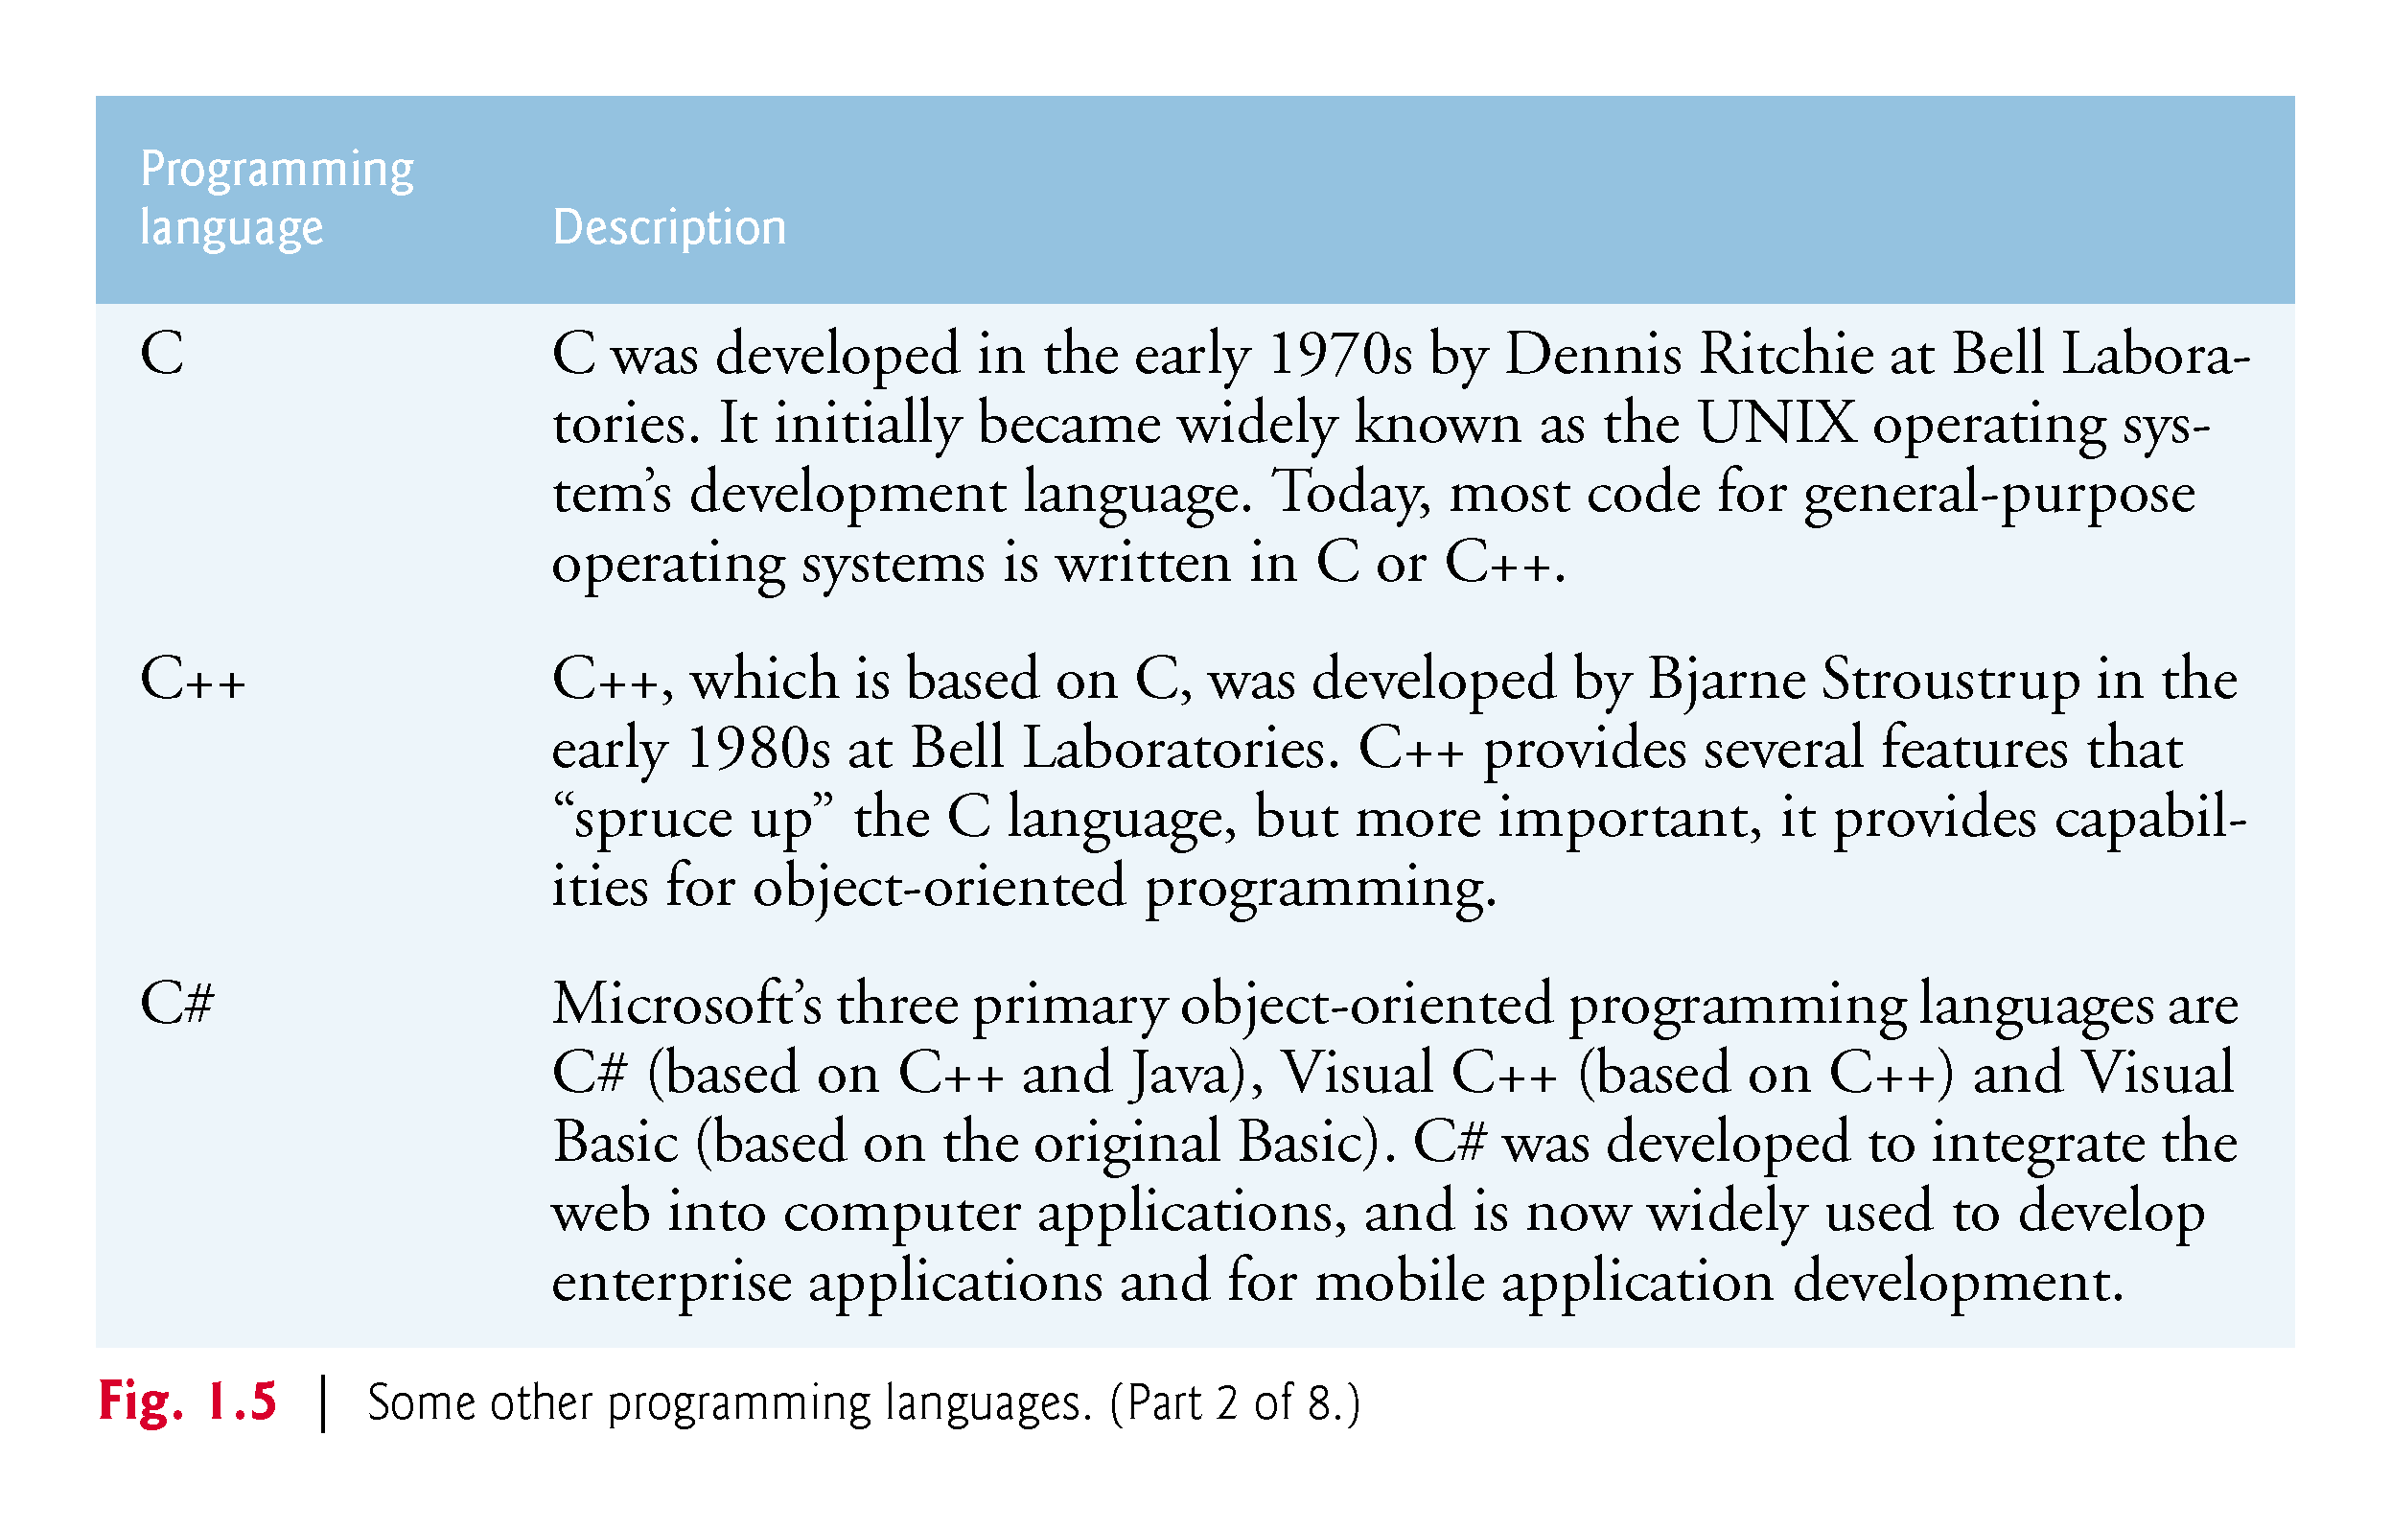

Slide 53
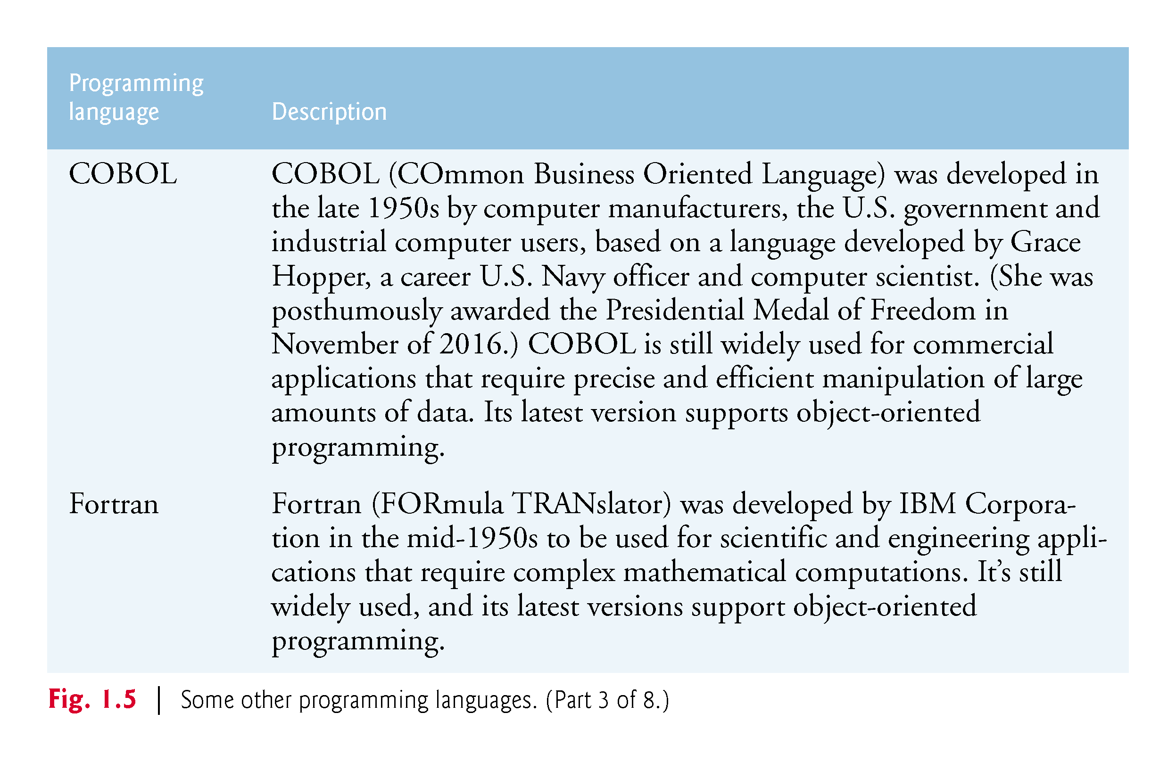

Slide 54
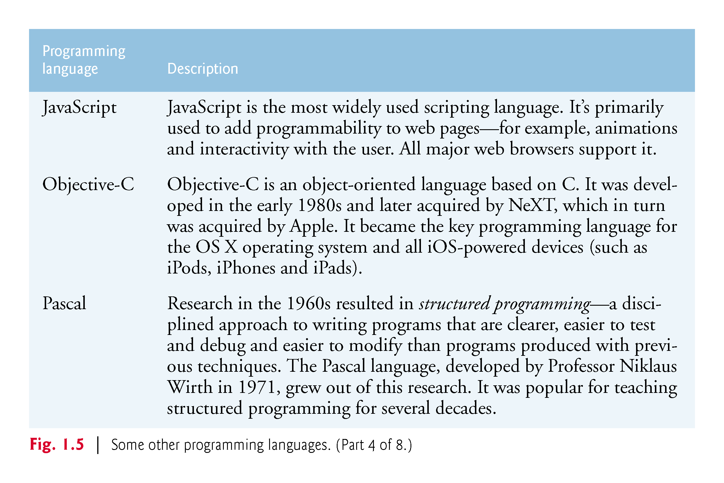

Slide 55
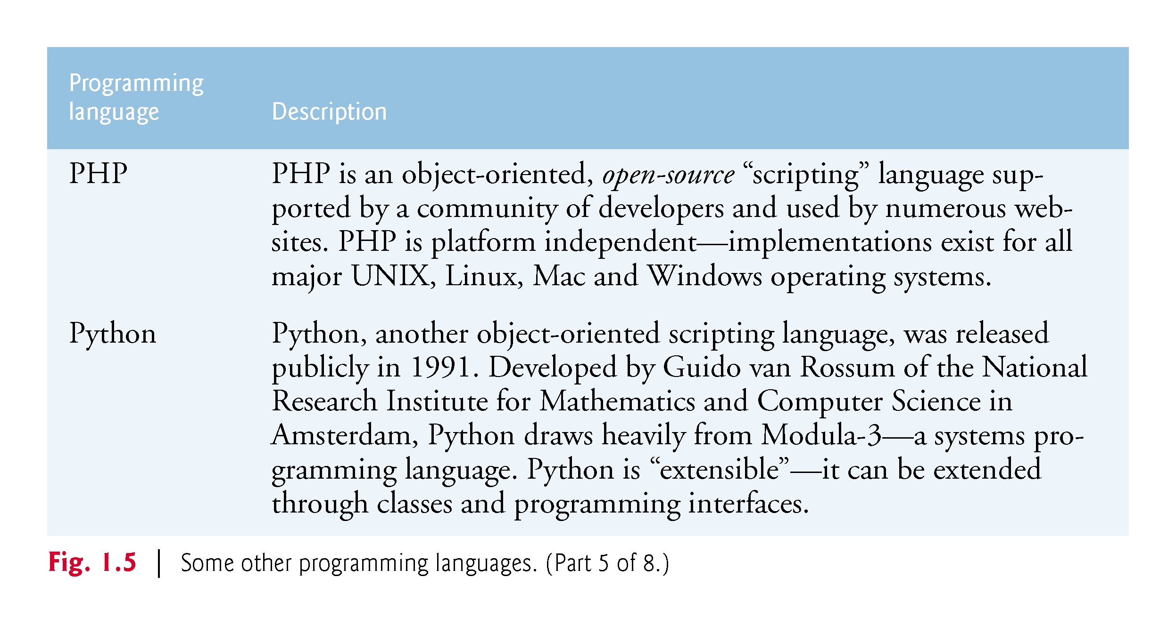

Slide 56
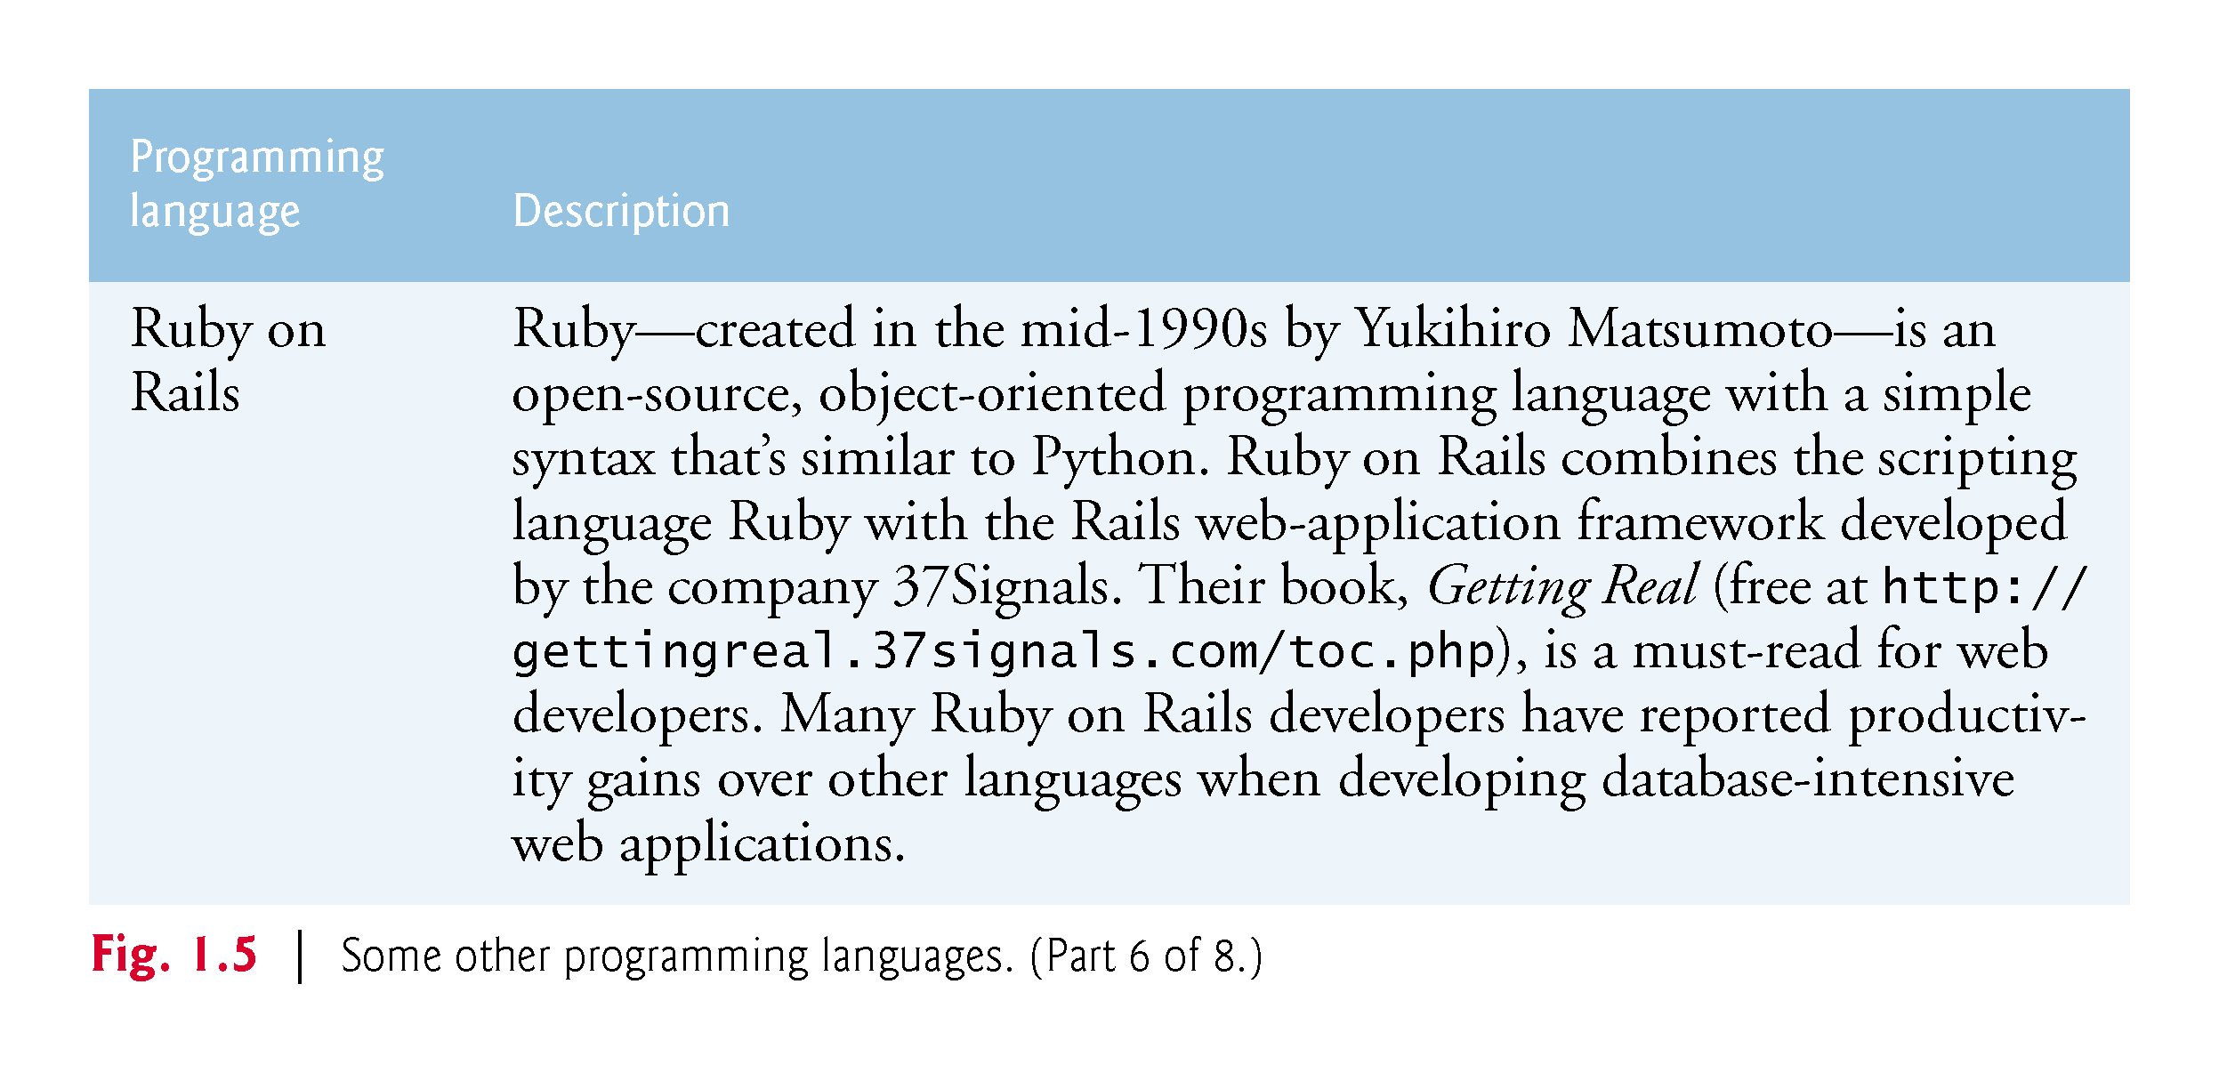

Slide 57
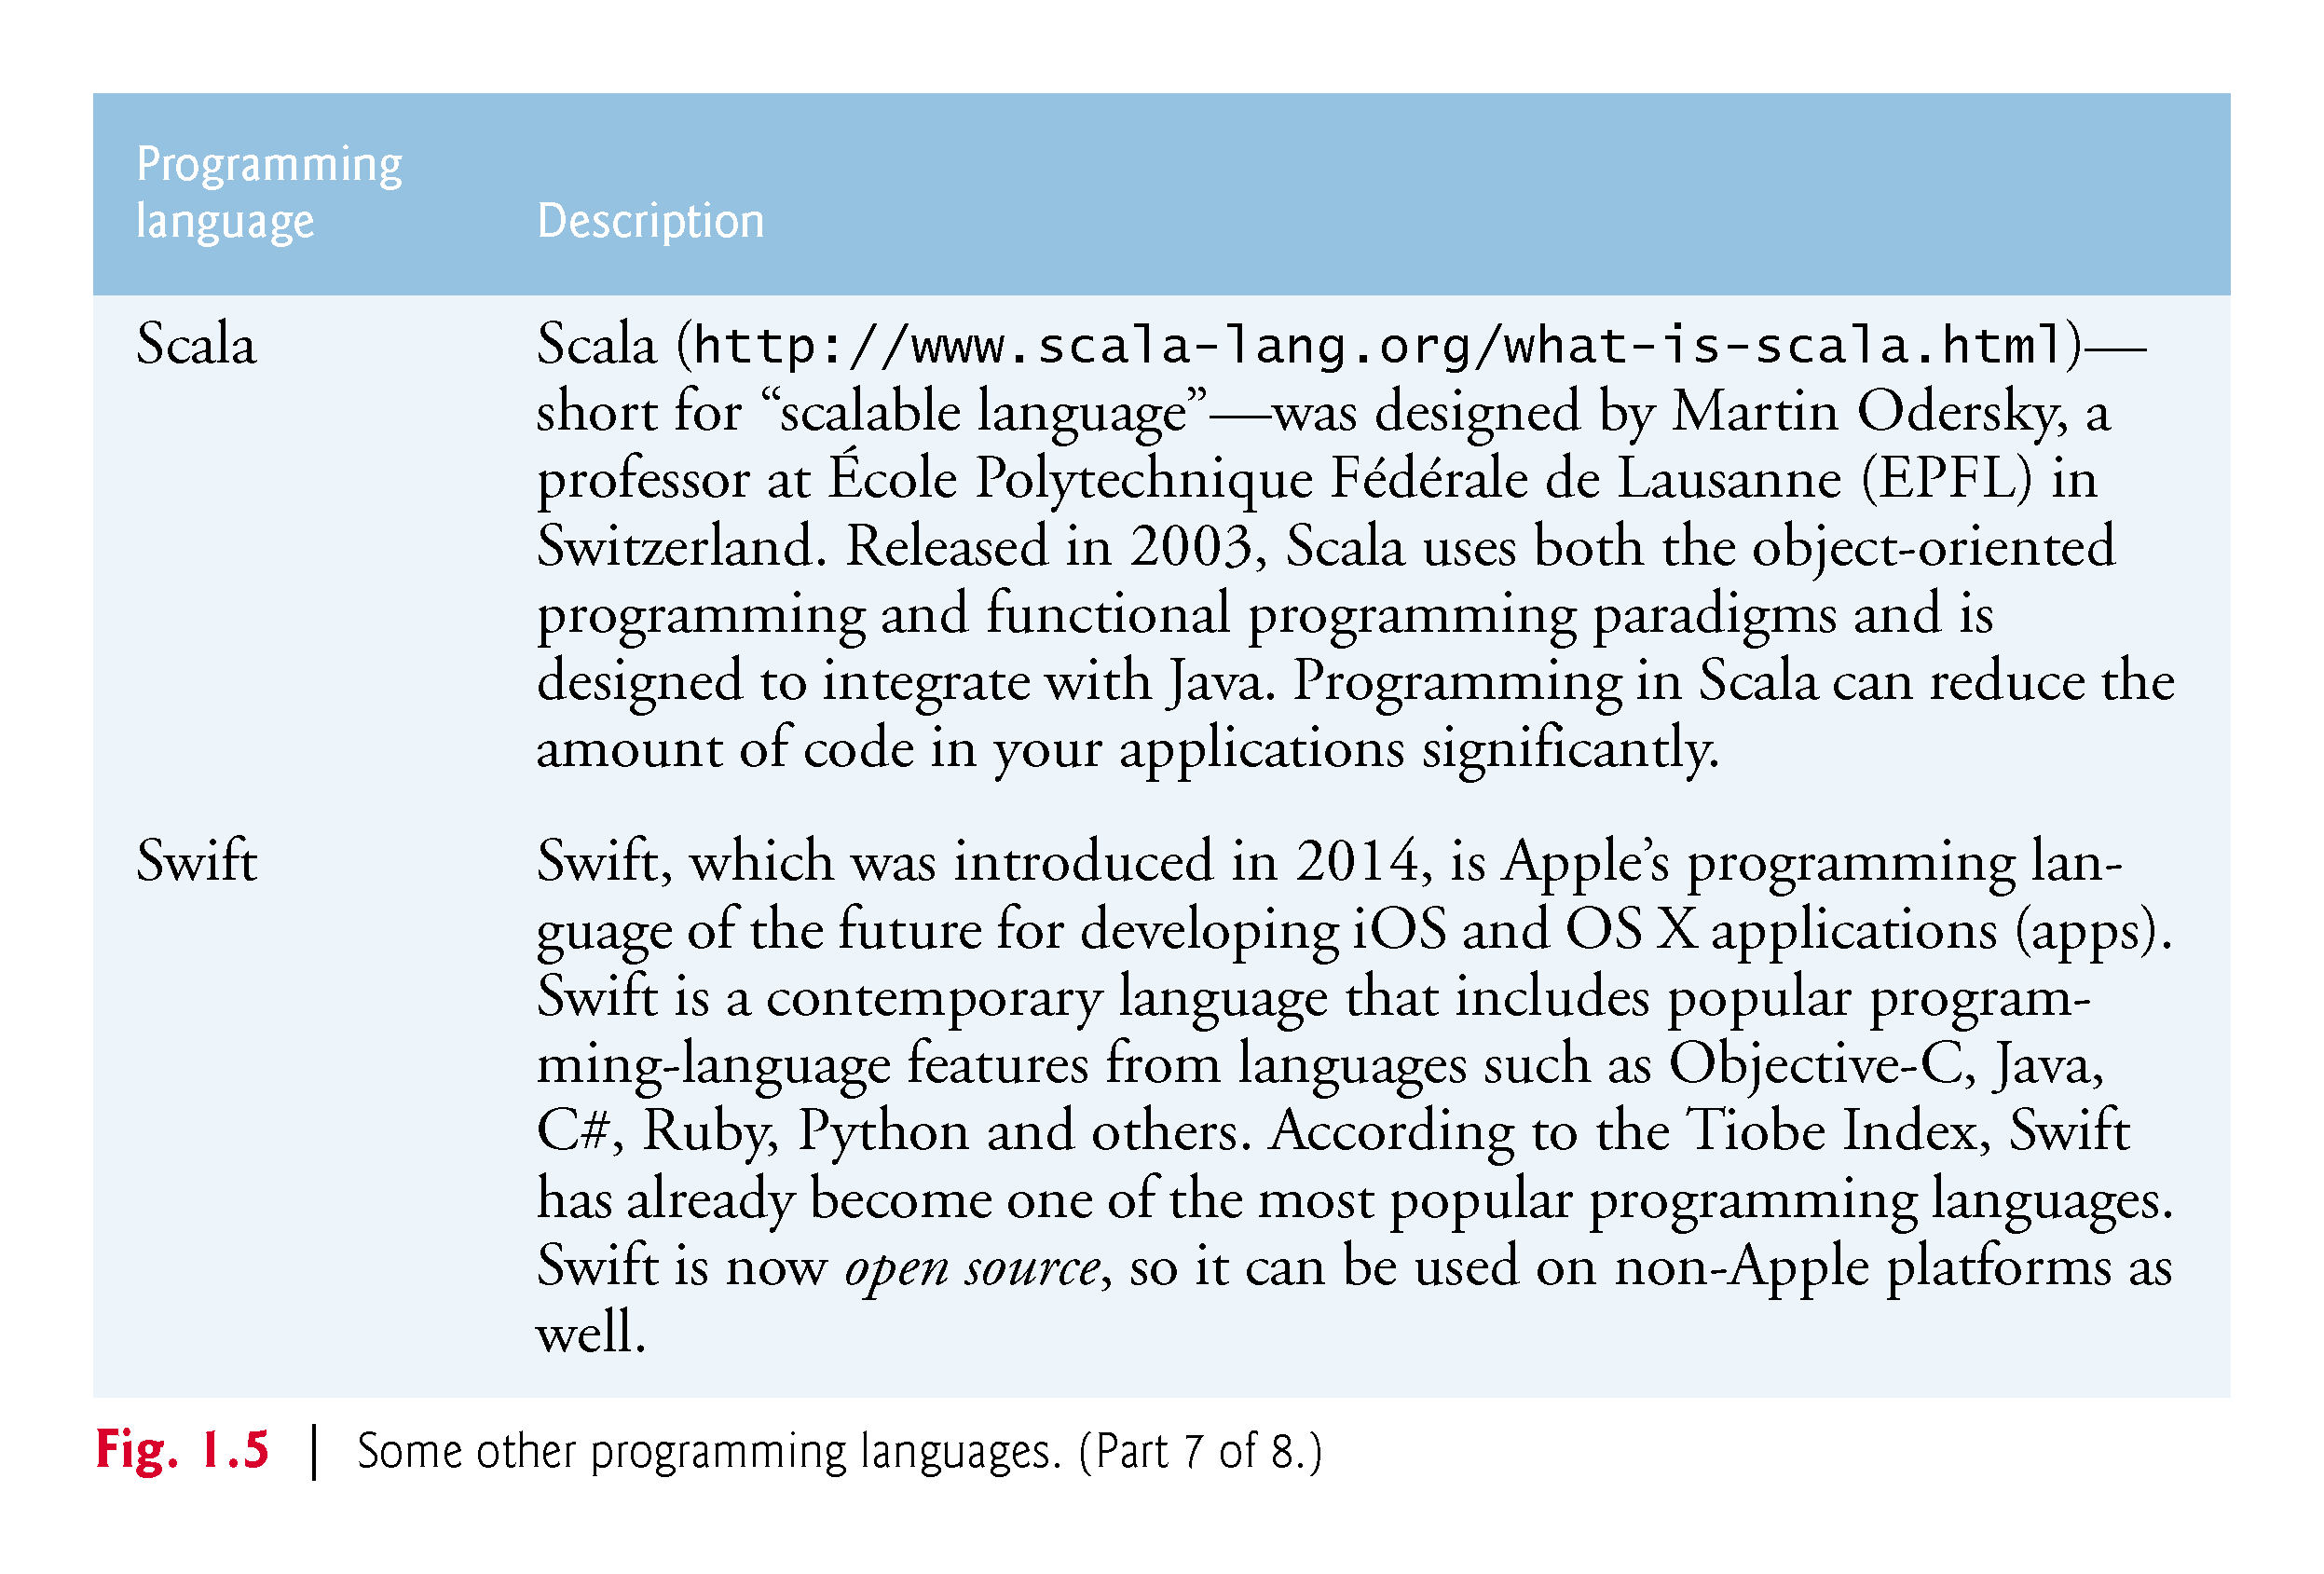

Slide 58
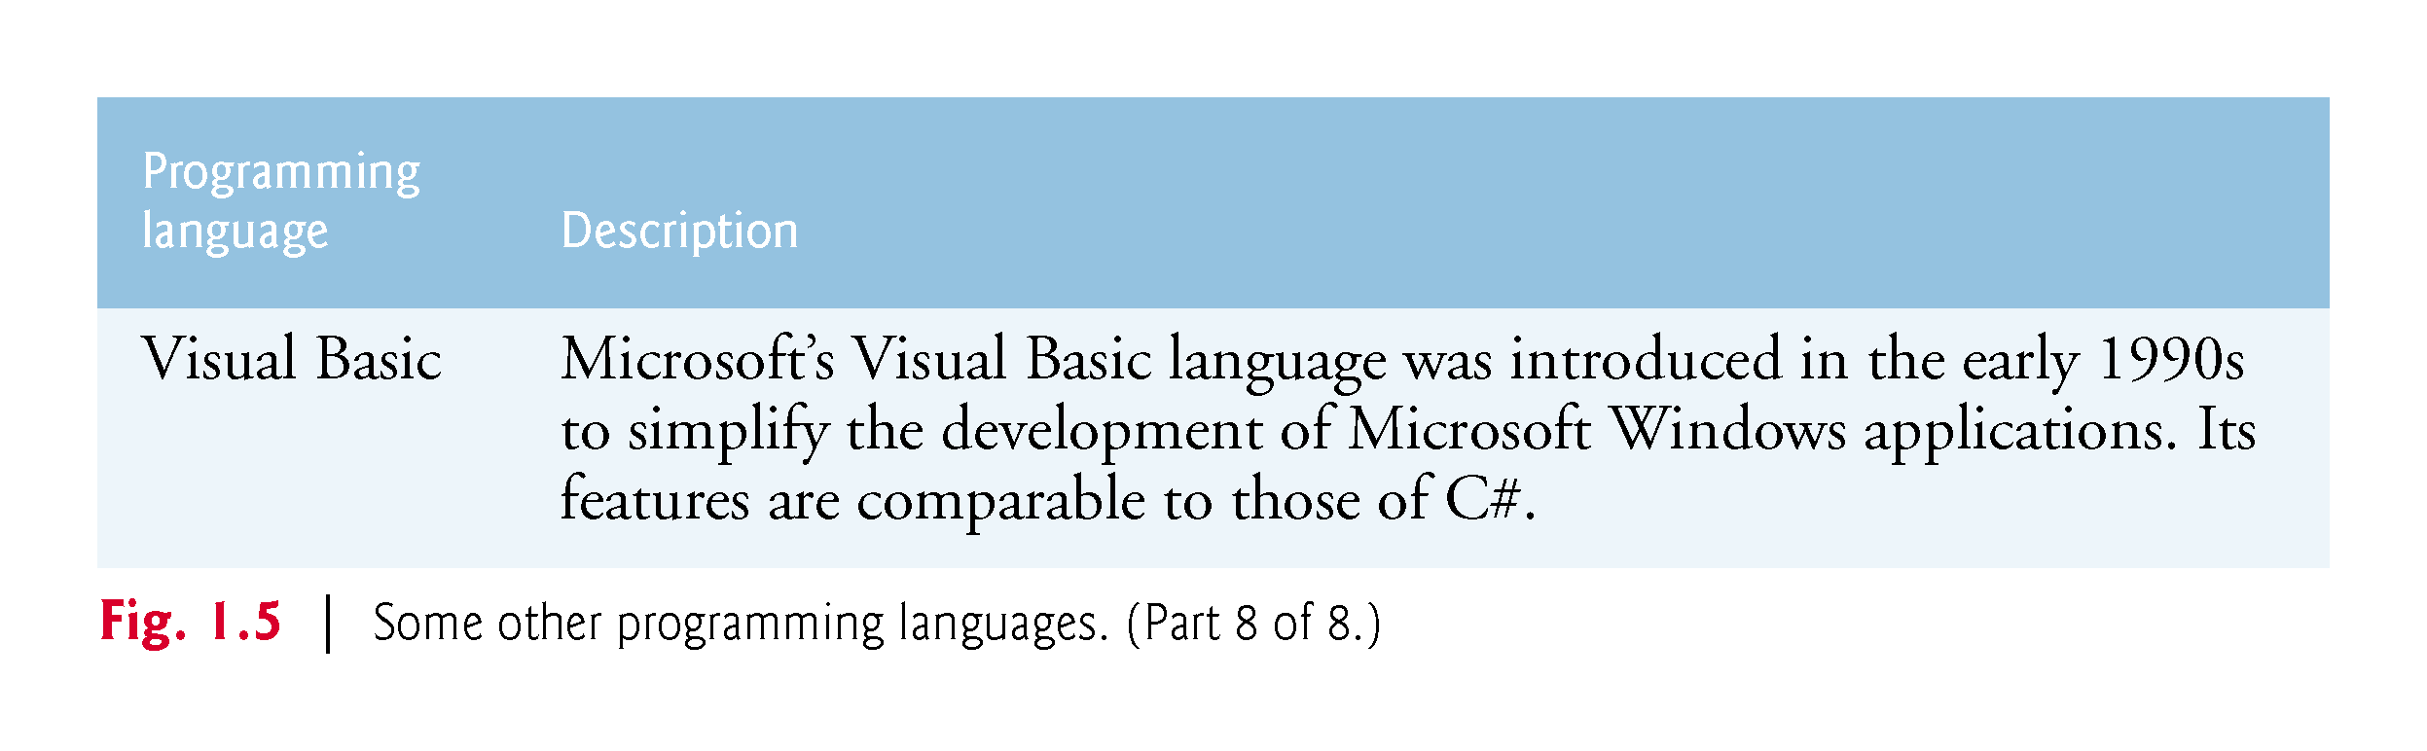

Slide 59
1.8 Java
The microprocessor revolution’s most important contribution to date is that it enabled the development of personal computers.
Microprocessors also have had a profound impact in intelligent- consumer-electronic devices, including the recent explosion in the “Internet of Things.”
Recognizing this early on, Sun Microsystems in 1991 funded an internal corporate research project led by James Gosling, which resulted in a C++-based object-oriented programming language that Sun called Java.
Using Java, you can write programs that will run on a great variety of computer systems and computer-controlled devices. This is sometimes called “write once, run anywhere.”

Slide 60
1.8 Java (Cont.)
Java drew the attention of the business community because of the phenomenal interest in the Internet.
Now used to develop large-scale enterprise applications, to enhance the functionality of web servers, to provide applications for consumer devices, to develop robotics software and for many other purposes.
Also the key language for developing Android smartphone and tablet apps.
Java has become the most widely used general-purpose programming language with more than 10 million developers.

Slide 61
1.8 Java (Cont.)
Java Class Libraries
Rich collections of existing classes and methods
Also known as the Java APIs (Application Programming Interfaces).
https://docs.oracle.com/javase/8/docs/api/

Slide 62
1.9 A Typical Java Development Environment
Normally there are five phases to create and execute a Java application:
edit
compile
load
verify
execute

Slide 63
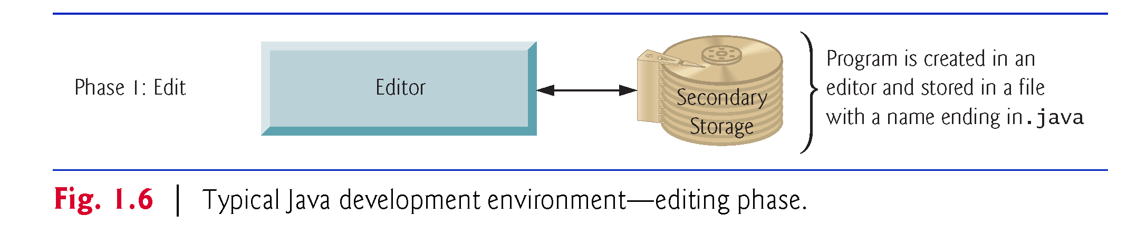
1.9 A Typical Java Development Environment (Cont.)
Phase 1: Editing a file with an editor program
Using the editor, you type a Java program (source code).
Make any necessary corrections.
Save the program.
Java source code files are given a name ending with the .java extension indicating that the file contains Java source code.

Slide 64
1.9 A Typical Java Development Environment (Cont.)
Two editors widely used on Linux systems are vi and emacs
Windows provides Notepad.
macOS provides TextEdit.
Many freeware and shareware editors are also available online, including
Notepad++ (http://notepad-plus-plus.org)
EditPlus (http://www.editplus.com)
TextPad (http://www.textpad.com)
jEdit (http://www.jedit.org) and more.

Slide 65
1.9 A Typical Java Development Environment (Cont.)
Integrated development environments (IDEs) provide tools that support the software development process, such as editors, debuggers for locating logic errors that cause programs to execute incorrectly and more.
The most popular Java IDEs are:
Eclipse (http://www.eclipse.org)
IntelliJ IDEA (http://www.jetbrains.com)
NetBeans (http://www.netbeans.org)

Slide 66
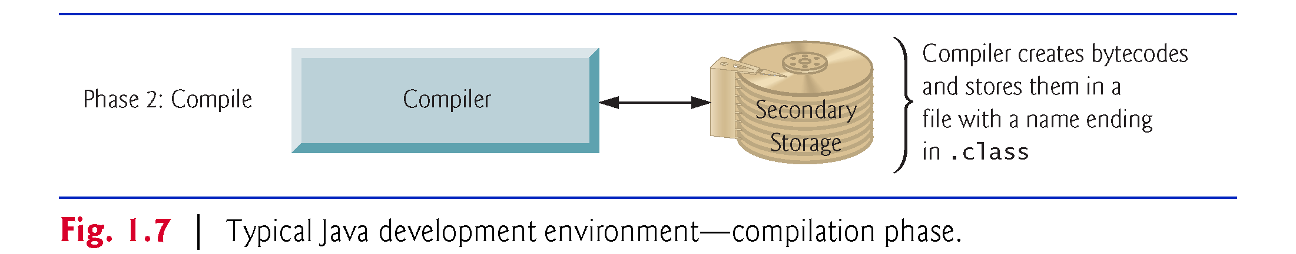
1.9 A Typical Java Development Environment (Cont.)
Phase 2: Compiling a Java Program into Bytecodes
Use the command javac (the Java compiler) to compile a program. For example, to compile a program called Welcome.java, you’d type
javac Welcome.java
If the program compiles, the compiler produces a .class file called Welcome.class that contains the compiled version.

Slide 67
1.9 A Typical Java Development Environment (Cont.)
Java compiler translates Java source code into bytecodes that represent the tasks to execute.
The Java Virtual Machine (JVM)—a part of the JDK and the foundation of the Java platform—executes bytecodes.
Virtual machine (VM)—a software application that simulates a computer
Hides the underlying operating system and hardware from the programs that interact with it.
If the same VM is implemented on many computer platforms, applications written for that type of VM can be used on all those platforms.

Slide 68
1.9 A Typical Java Development Environment (Cont.)
Bytecode instructions are platform independent
Bytecodes are portable
The same bytecode instructions can execute on any platform containing a JVM that understands the version of Java in which the bytecode instructions were compiled.
The JVM is invoked by the java command. For example, to execute a Java application called Welcome, you’d type the command
java Welcome

Slide 69
1.9 A Typical Java Development Environment (Cont.)
Phase 3: Loading a Program into Memory
The JVM places the program in memory to execute it—this is known as loading.
Class loader takes the .class files containing the program’s bytecodes and transfers them to primary memory.
Also loads any of the .class files provided by Java that your program uses.
The .class files can be loaded from a disk on your system or over a network.

Slide 70
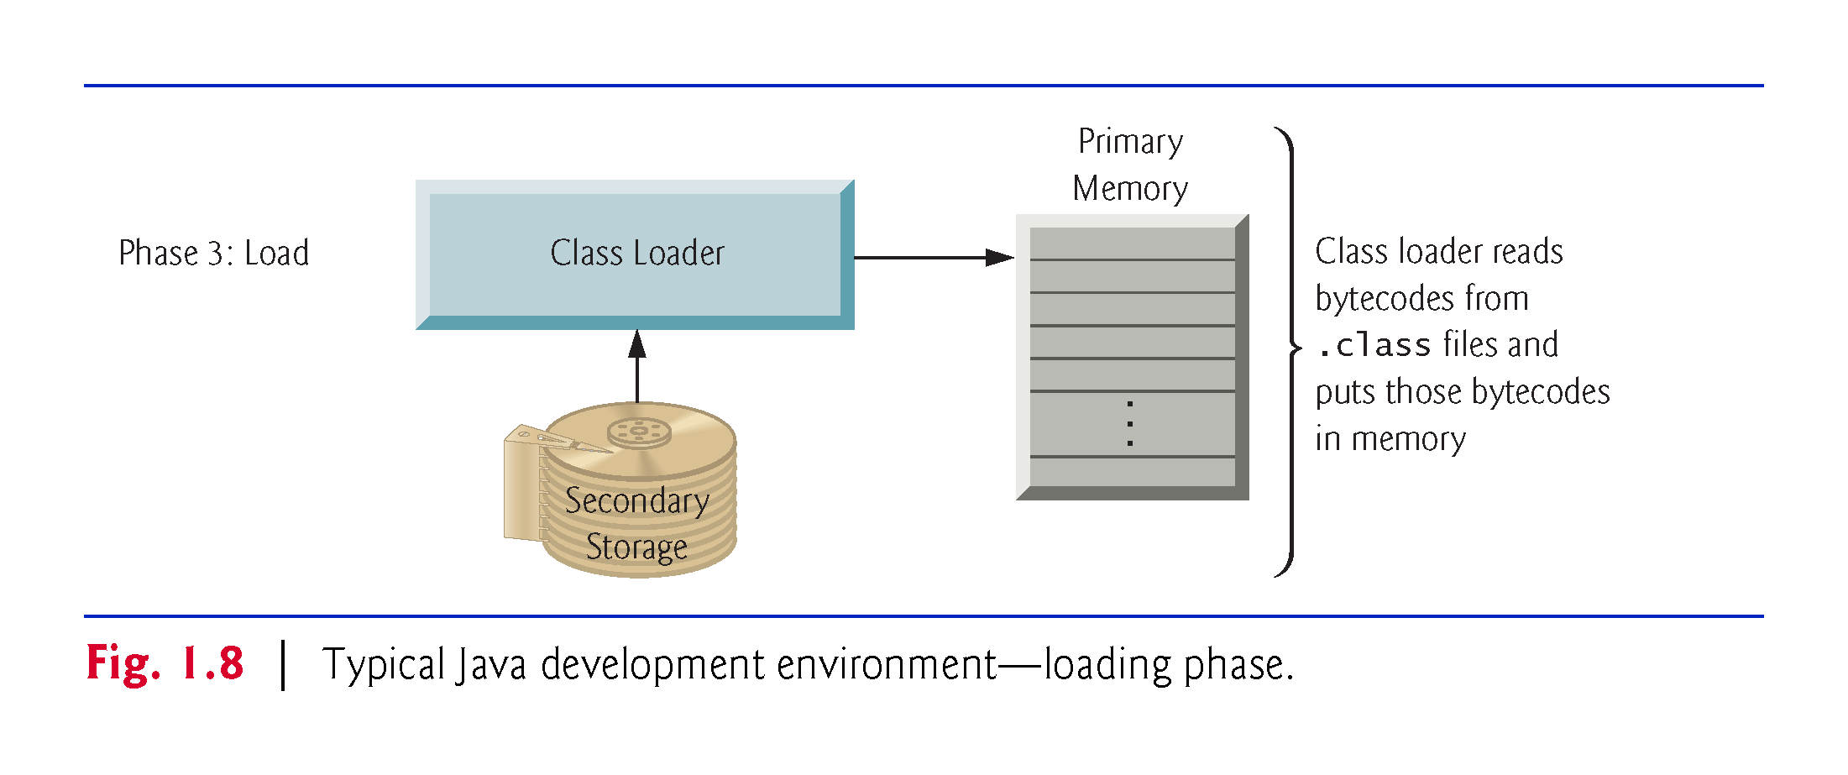

Slide 71
1.9 A Typical Java Development Environment (Cont.)
Phase 4: Bytecode Verification
As the classes are loaded, the bytecode verifier examines their bytecodes
Ensures that they’re valid and do not violate Java’s security restrictions.
Java enforces strong security to make sure that Java programs arriving over the network do not damage your files or your system (as computer viruses and worms might).

Slide 72
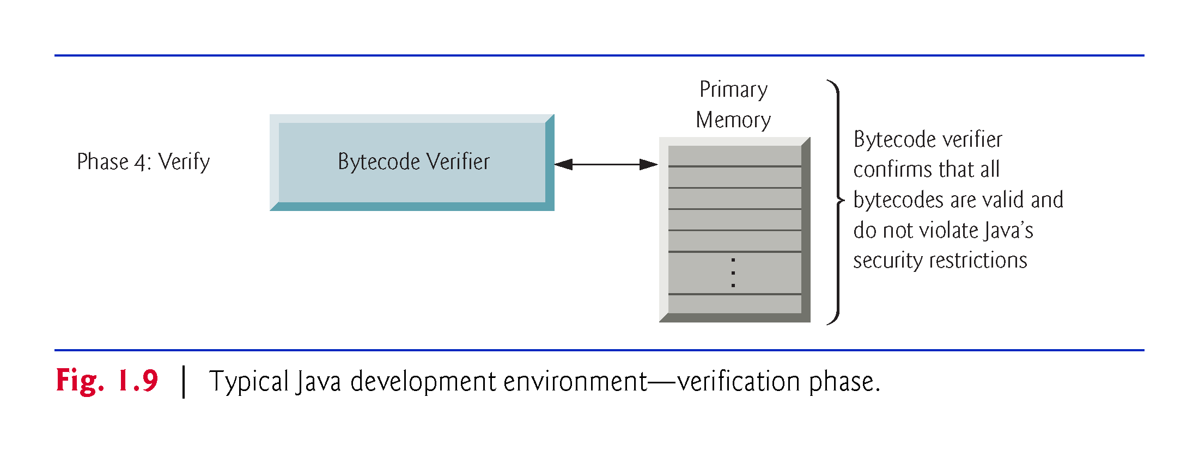

Slide 73
1.9 A Typical Java Development Environment (Cont.)
Phase 5: Execution
The JVM executes the program’s bytecodes.
JVMs typically execute bytecodes using a combination of interpretation and so-called just-in-time (JIT) compilation.
Analyzes the bytecodes as they’re interpreted
A just-in-time (JIT) compiler—such as Oracle’s Java HotSpot™ compiler—translates the bytecodes into the underlying computer’s machine language.

Slide 74
1.9 A Typical Java Development Environment (Cont.)
Java programs go through two compilation phases
One in which source code is translated into bytecodes (for portability across JVMs on different computer platforms) and
A second in which, during execution, the bytecodes are translated into machine language for the actual computer on which the program executes.

Slide 75
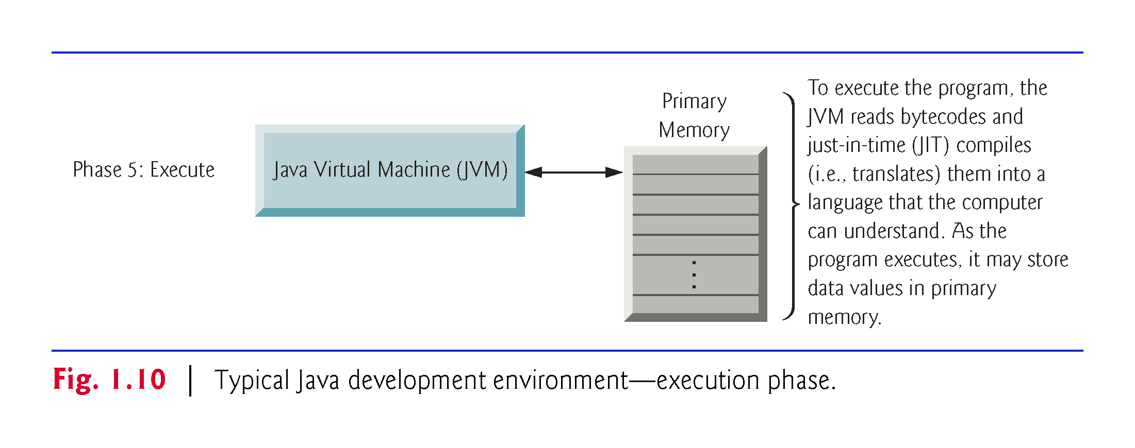

Slide 76
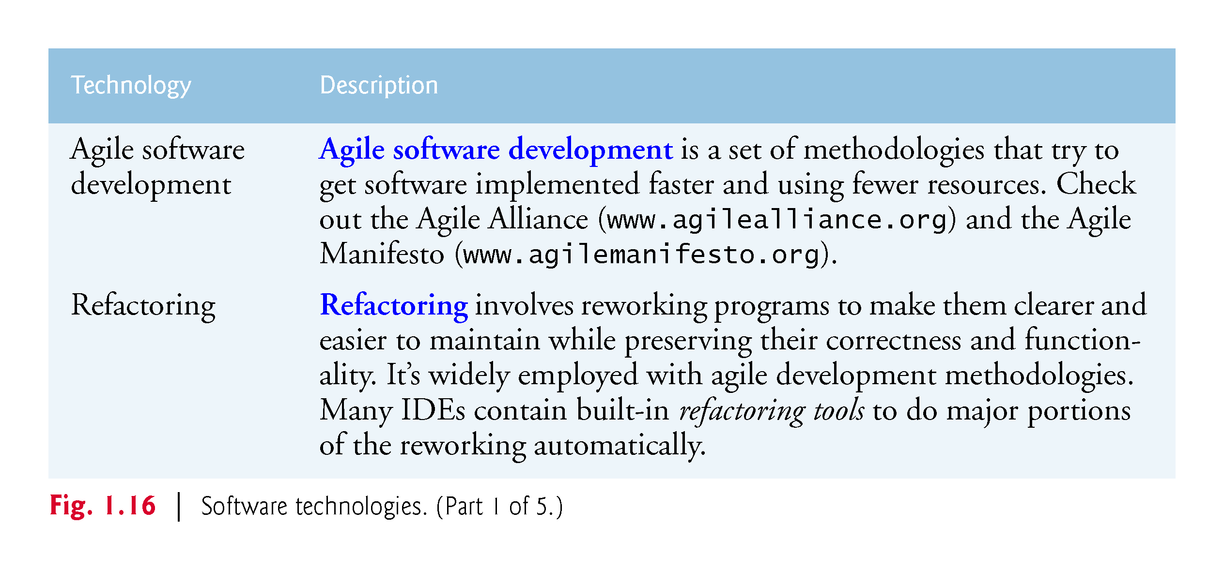
1.12 Software Technologies

Slide 77
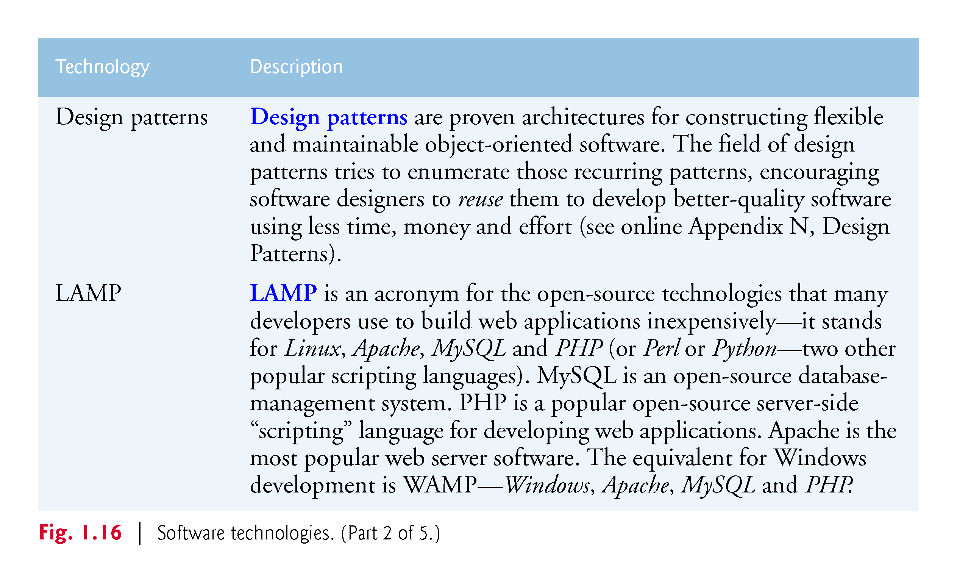

Slide 78
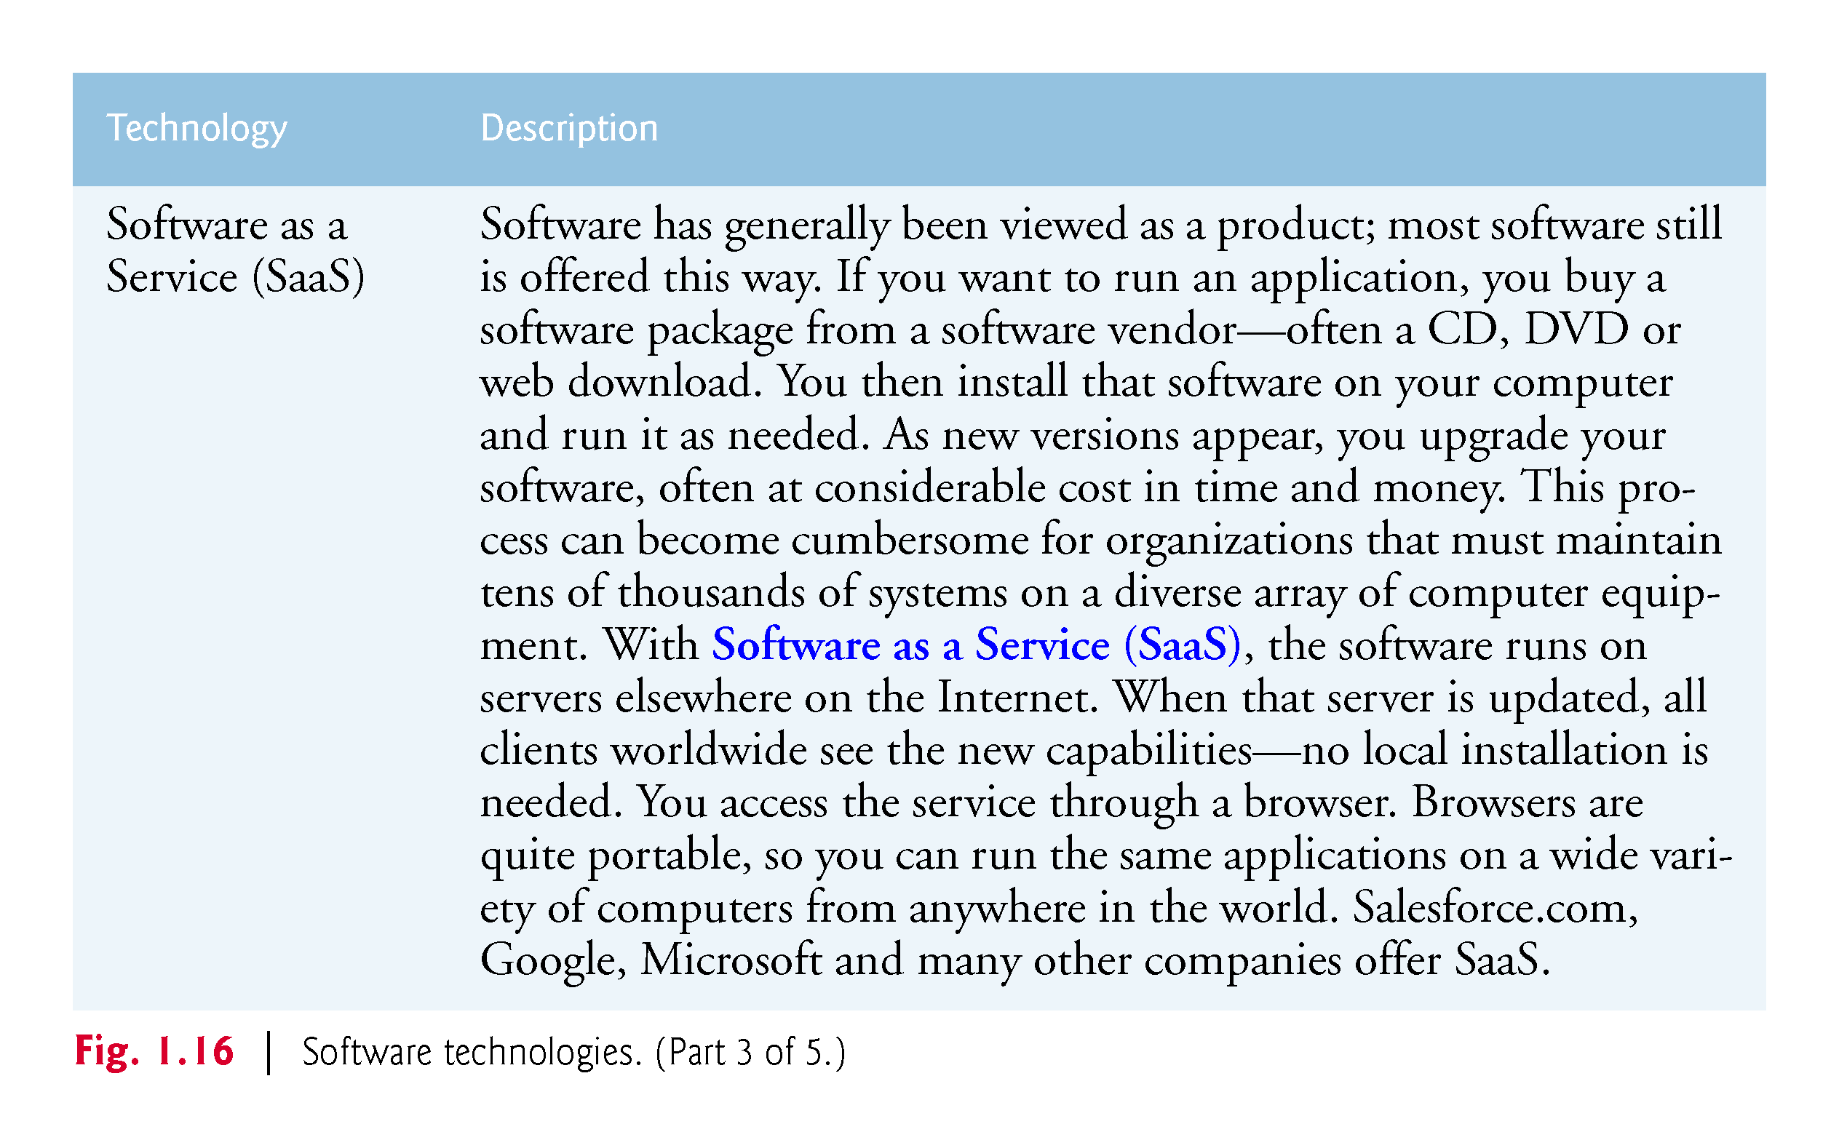

Slide 79
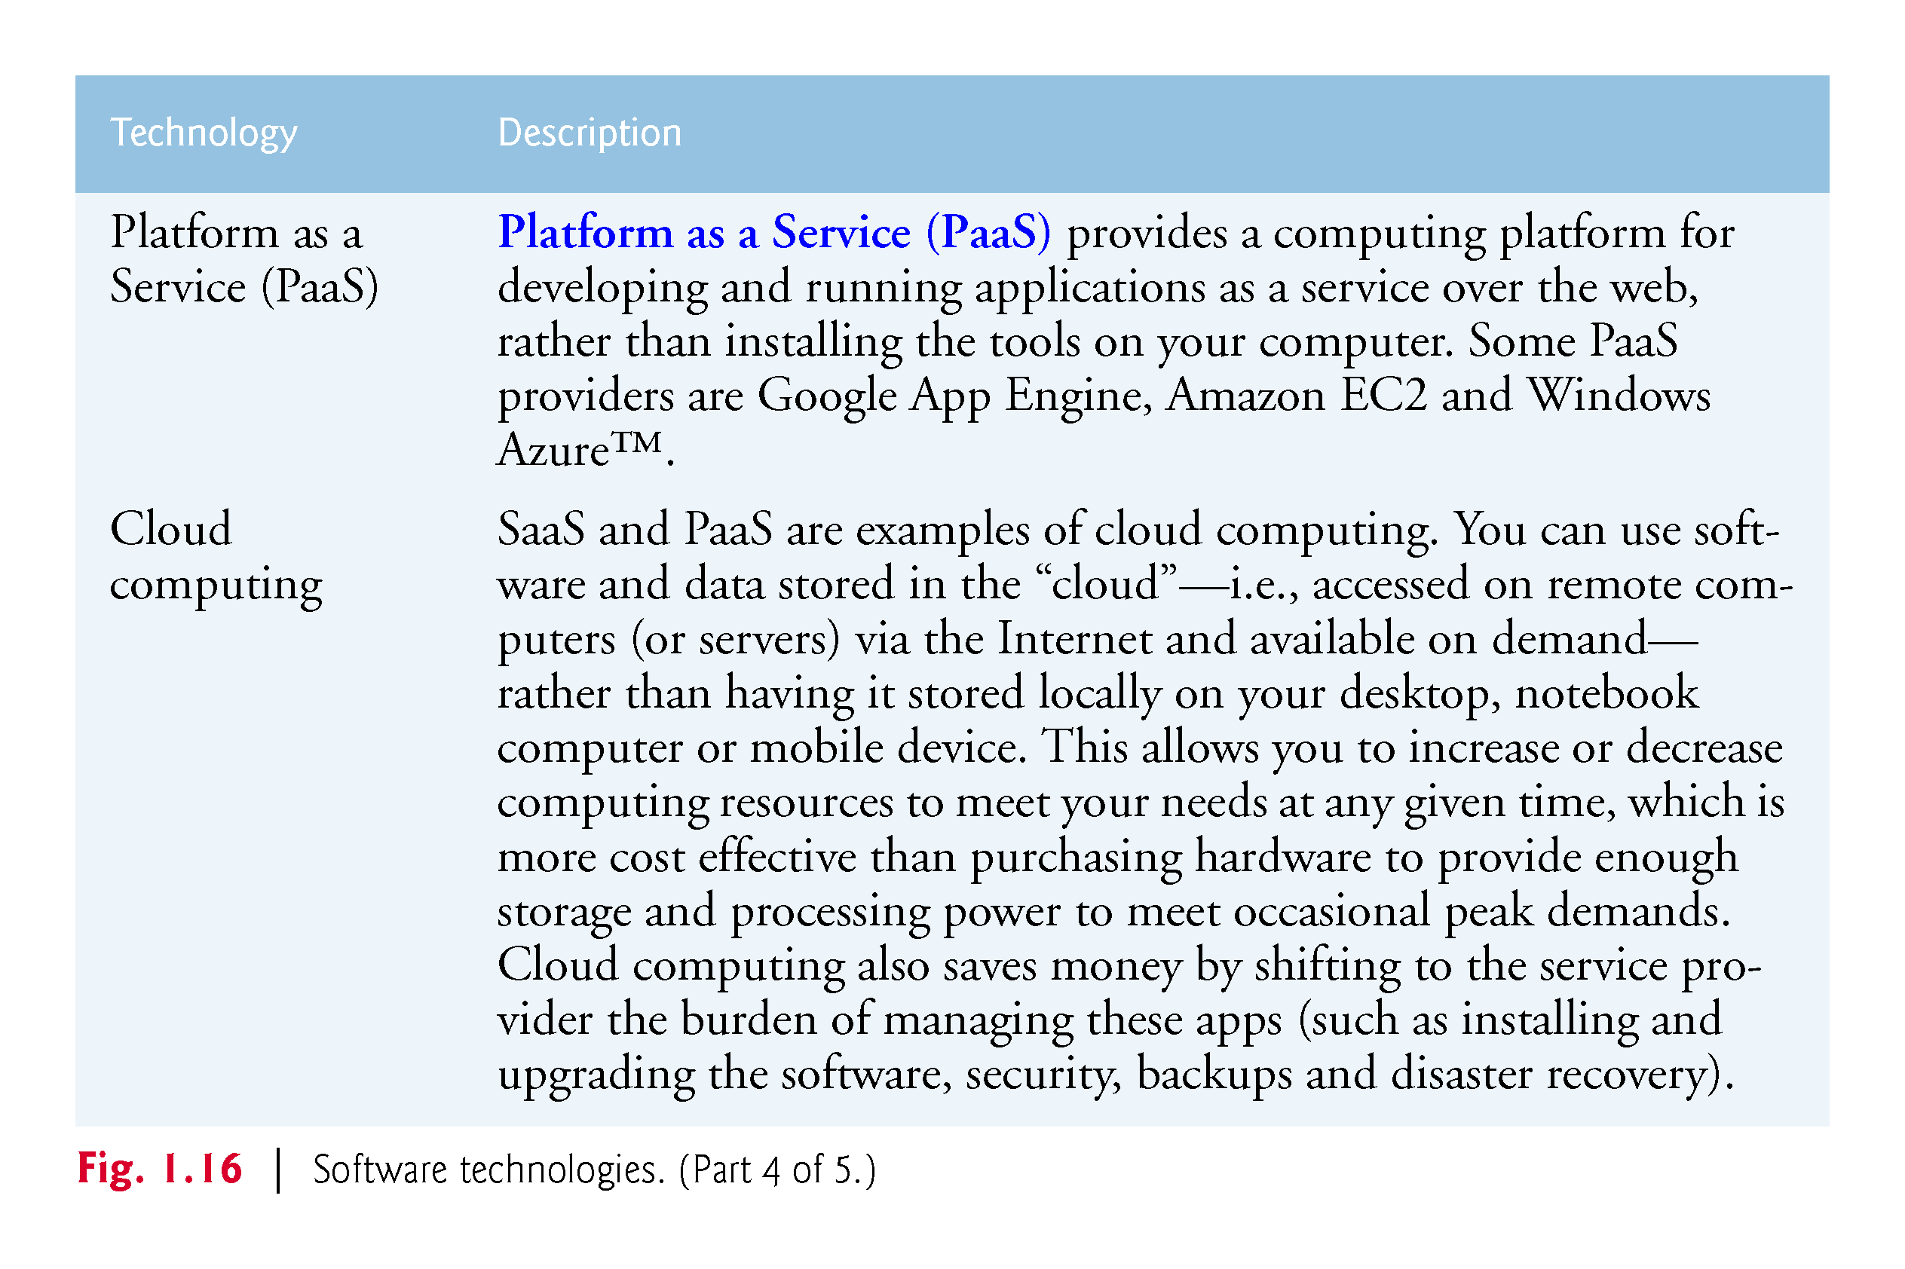

Slide 80
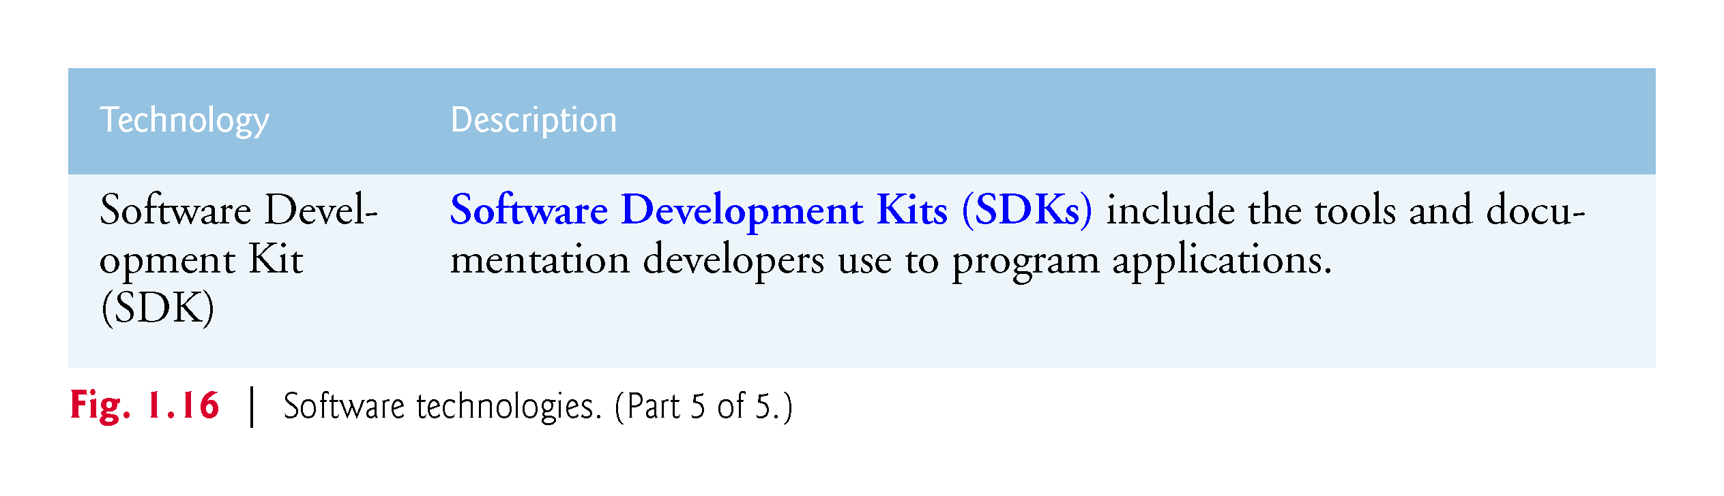

Slide 81
1.14 Getting Your Questions Answered
There are many online forums in which you can get your Java questions answered and interact with other Java programmers.
Some popular Java and general programming forums include:
Google
StackOverflow.com
Coderanch.com
The Oracle Java Forum—https://community.oracle.com/community/java

Slide 82
Chapter Objectives – What we covered
Identify computer hardware, software, networking basics.
Express the levels of the data hierarchy within computers.
Compare the different types of programming languages.
Explain object-oriented programming basics.
Identify the components that make up a typical Java programming environment.

Slide 83
Questions?

